Slide 1
Research Presentation Agenda by Dr. Gail Hunter
Overview/Rationale
Zone Webpages
Comparing Survey Results
  Innerscape, Identity Development & Word Associations
Conclusion

Slide 2
Research Foundation
My 2nd master’s thesis is on the topic of Adolescent Identity
  based on the work of Seth Schwartz.
My doctoral research topic was Multicultural Competence in Counselor Education
  based on the work of Manivong J. Ratts 2015/16,
  which I have converted into a professional development activity/course.
My 1st master’s project is a multimedia production of Maya Angelou’s Inaugural Poem ‘On the Pulse of Morning’,
  which is listed on a commemorative website.

Slide 3
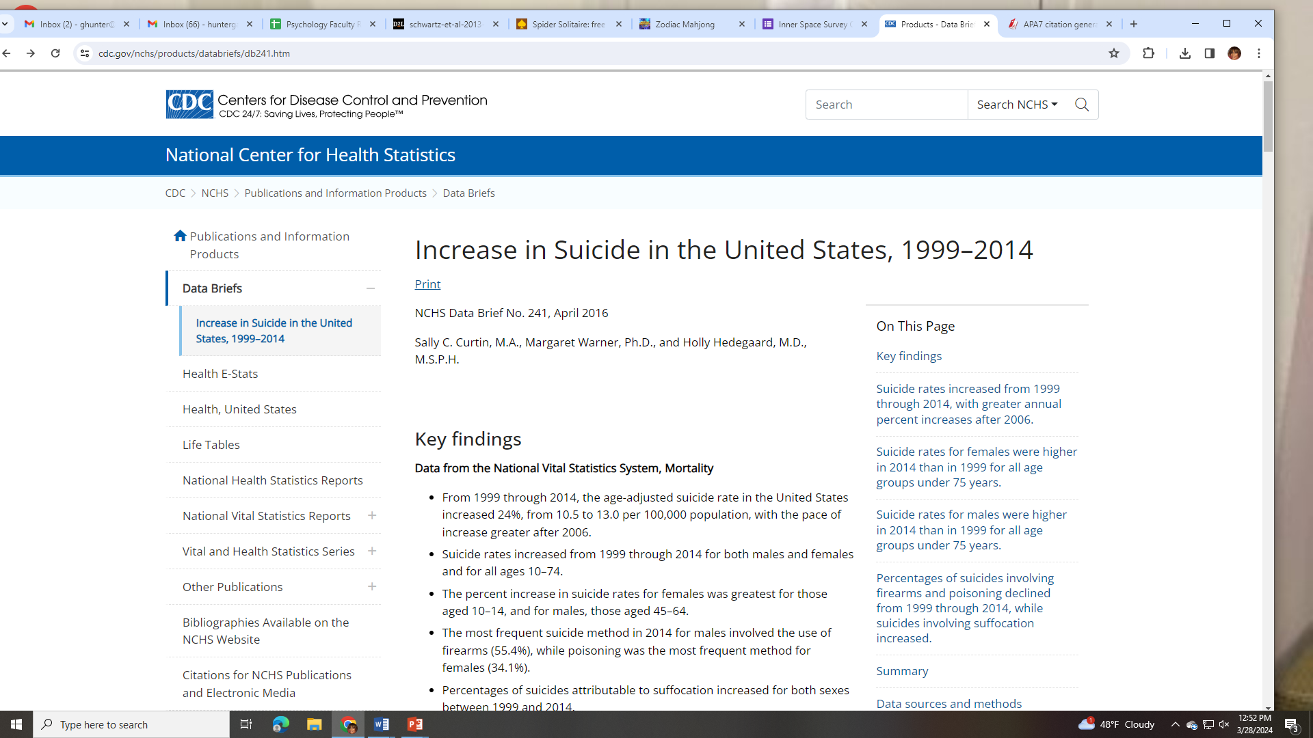
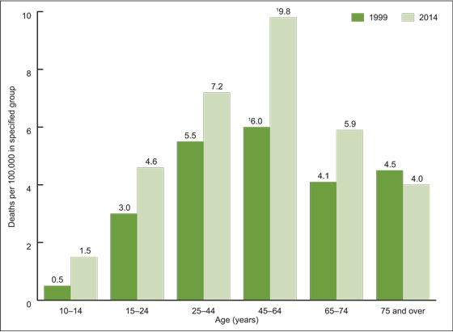
problem
Youth suicide rates rose 62% from 2007 to 2021: ‘People feel hopeless,’ one recent grad says
Shrikant, A. (n.d.). Youth suicide rates rose 62% from 2007 to 2021: 'People feel hopeless,' one recent grad says. CNBC. https://www.cnbc.com/2023/12/05/youth-suicide-rates-rose-62percent-from-2007-to-2021.html
Products - Data briefs - Number 241 - April 2016. (2019, June 7). Centers for Disease Control and Prevention. https://www.cdc.gov/nchs/products/databriefs/db241.htm

Slide 4
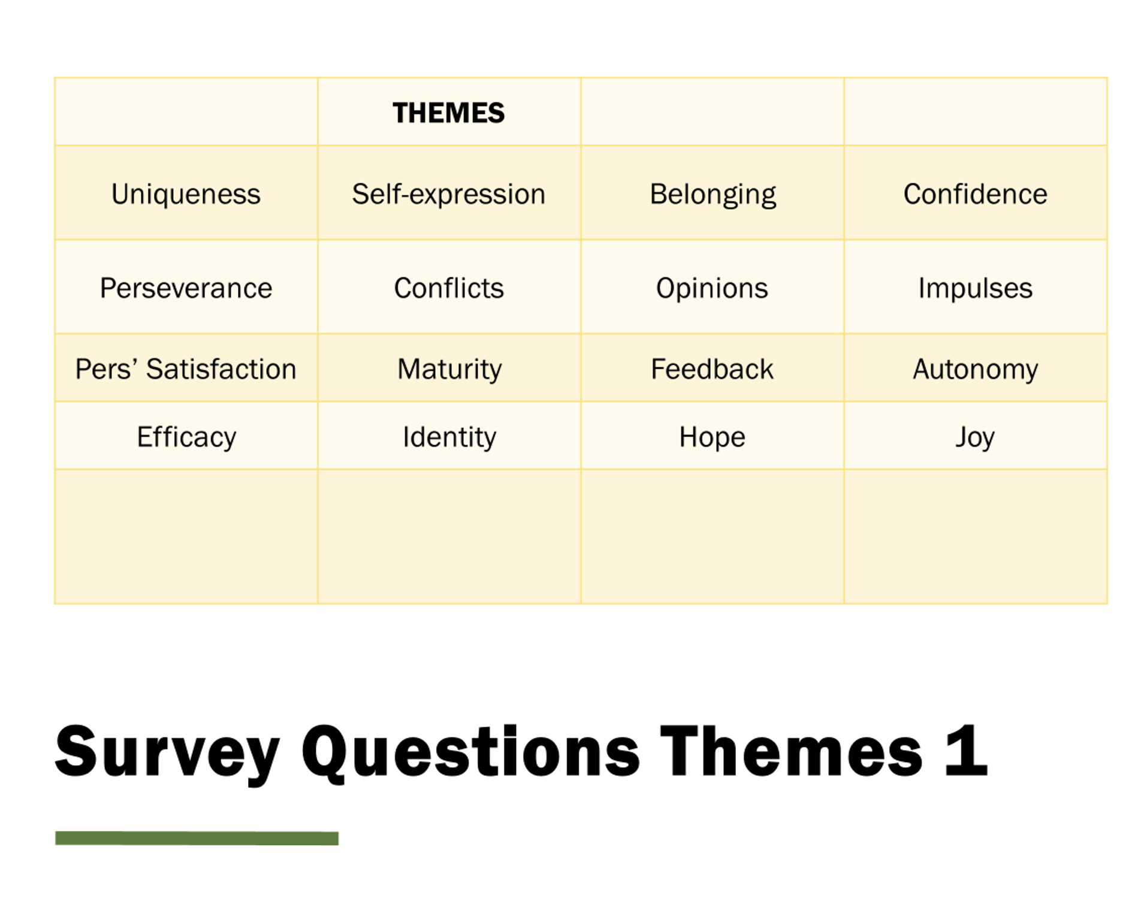

Slide 5
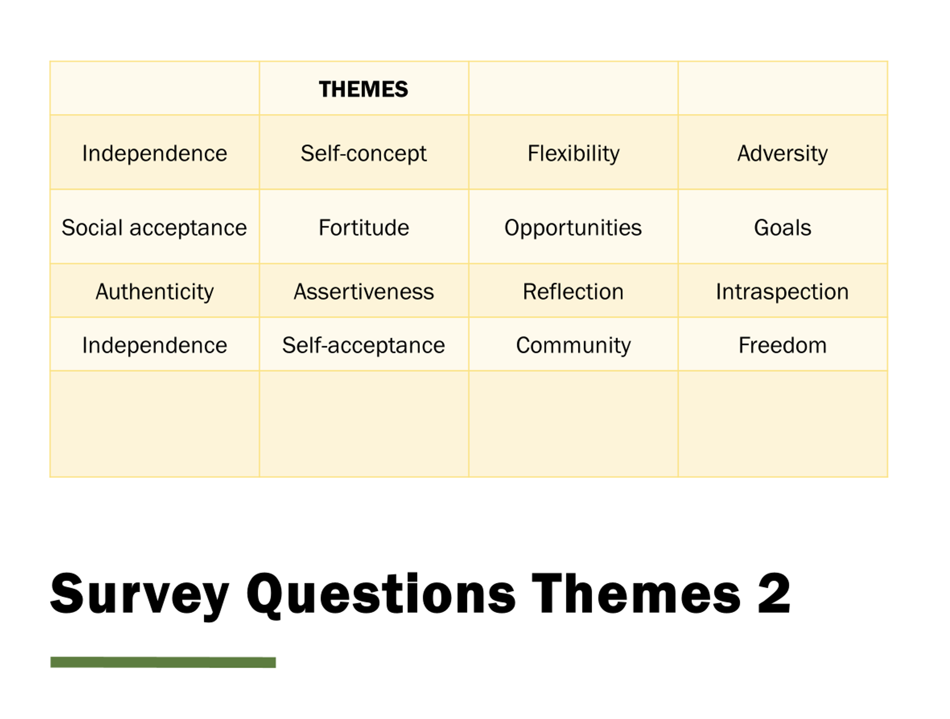

Slide 6
Survey Instrument | Sample sizes | Last Data Collected | Began Data Collection
Identity Correlates | 15 Mixed sample | 2024 | 2014
Word Association | 21/15 | 2024 | 2013
InnerSpace | 8/41 | 2024 | 2014
Social Cognition | 7/40 | 2024 | 2015
Self-Awareness | 10/32 | 2024 | 2015

Slide 7
Schwartz, S. J., Zamboanga, B. L., Luyckx, K., Meca, A., & Ritchie, R. A. (2013). Identity in emerging adulthood. Emerging Adulthood, 1(2), 96-113. https://doi.org/10.1177/2167696813479781
Surveys designed by
Dr. Gail Hunter

Slide 8


Identity Theory
Abstract
The present article presents a review of identity status-based theory and research with adolescents and emerging adults, with some coverage of related approaches such as narrative identity and identity style.
In the first section, we review Erikson’s theory
of identity and early identity status research examining differences in personality and cognitive variables across statuses.
We then review two contemporary identity models that extend identity status theory and explicitly frame identity development as a dynamic and iterative process.
We also review work that has focused on specific domains of identity.
The second section of the article discusses mental and physical health correlates of identity processes and statuses.
The article concludes with recommendations for future identity research with adolescent and emerging adult populations.

Slide 9



Slide 10
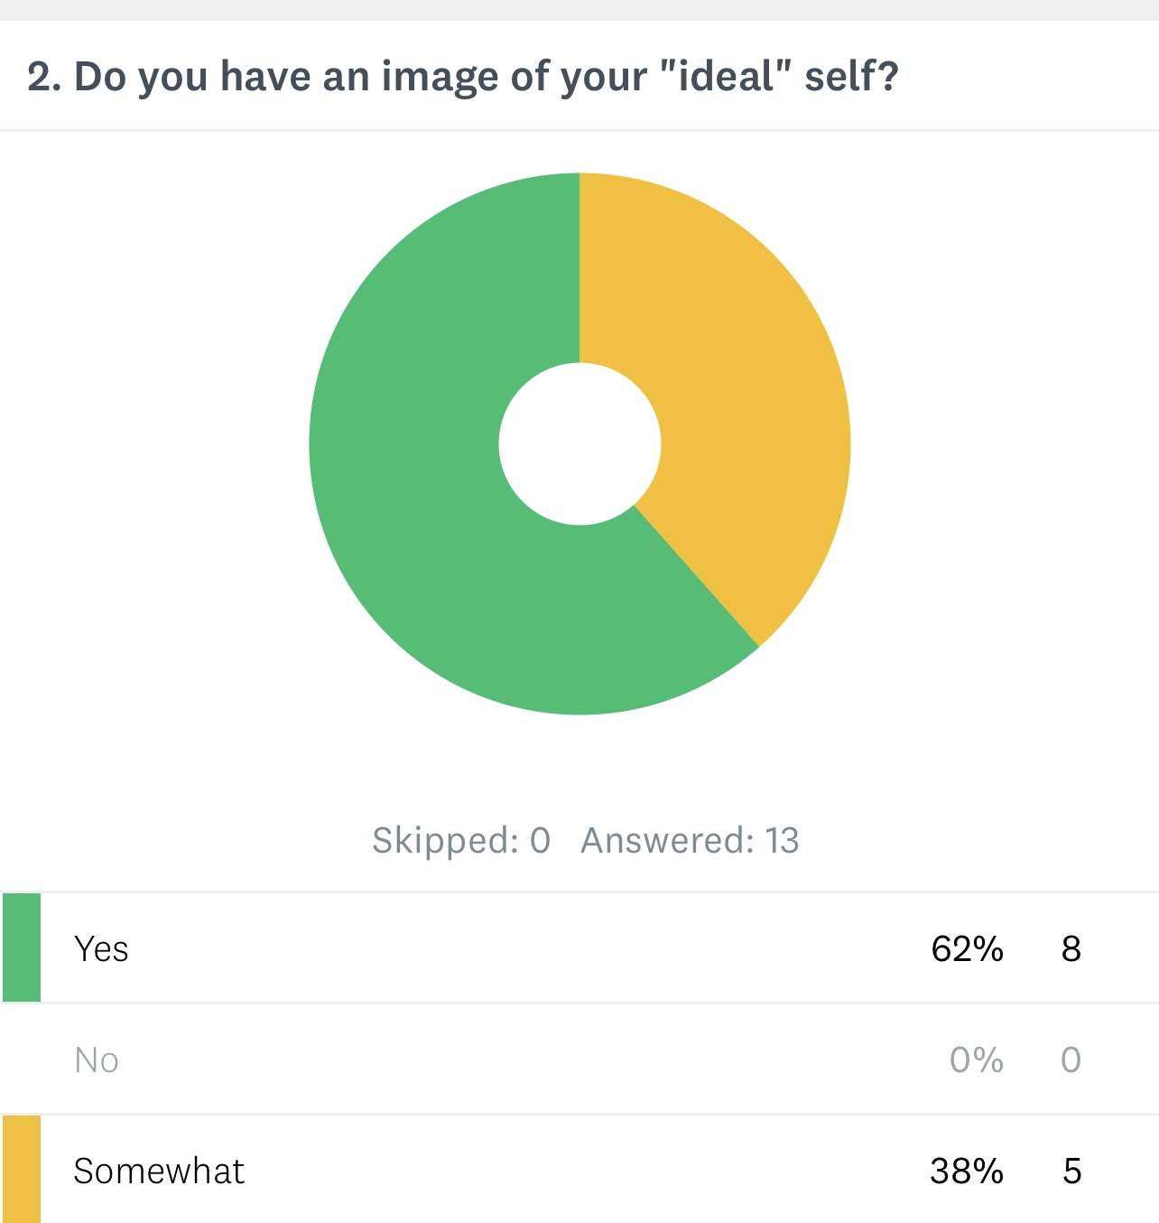
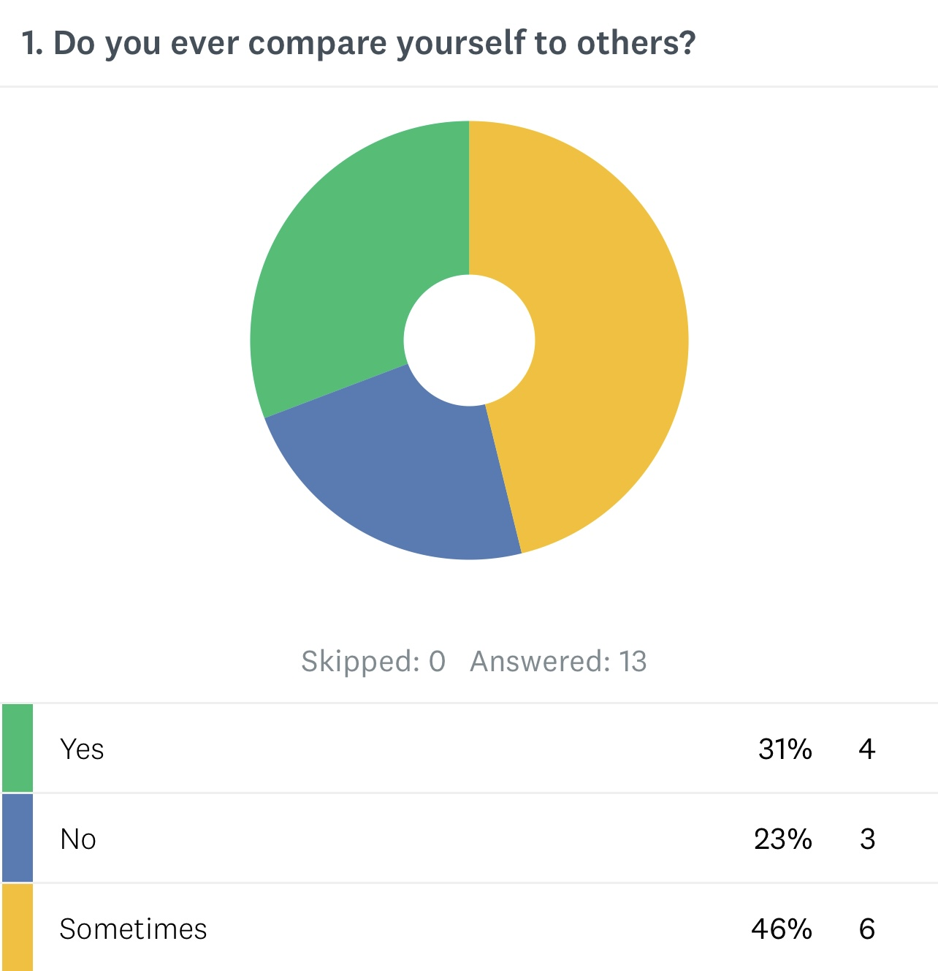
Uniqueness & pers’ Satisfaction

Slide 11
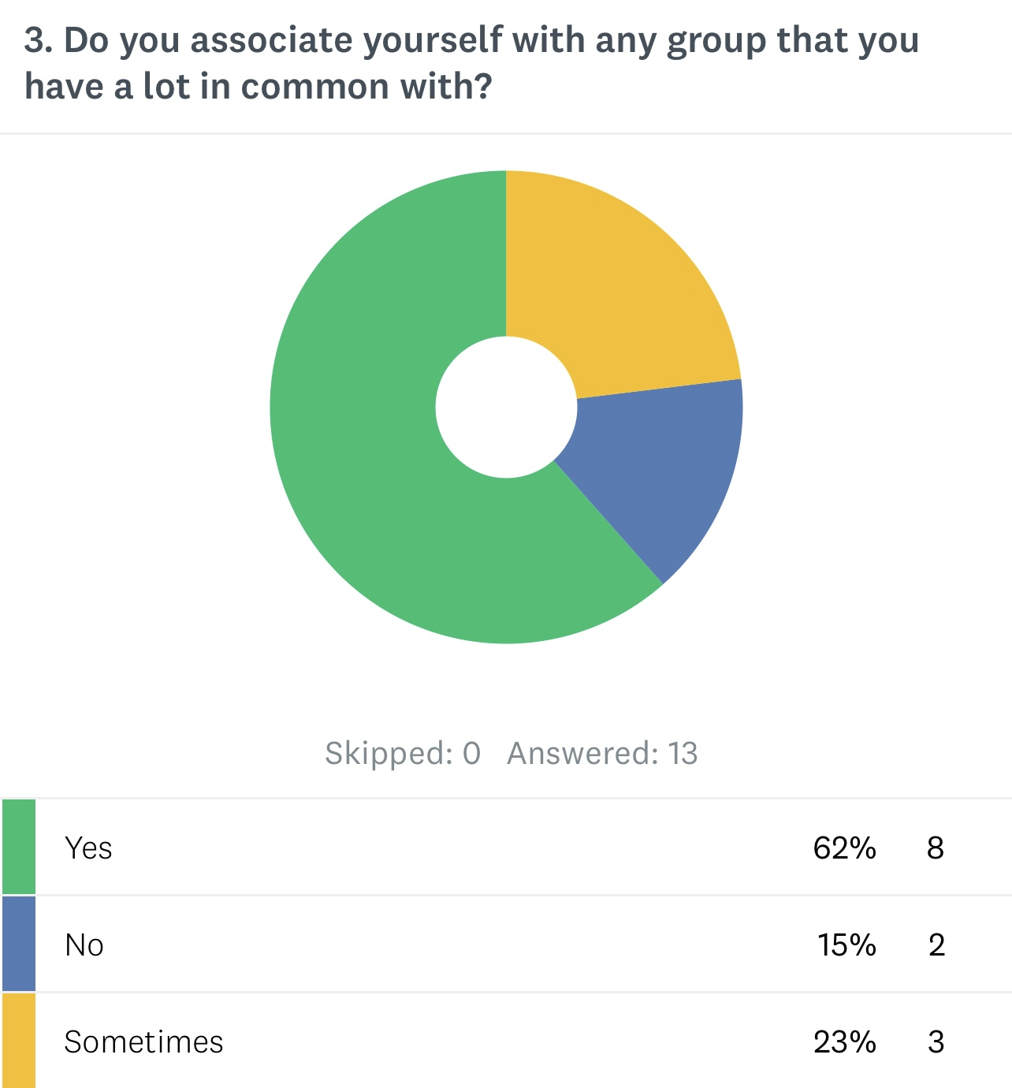
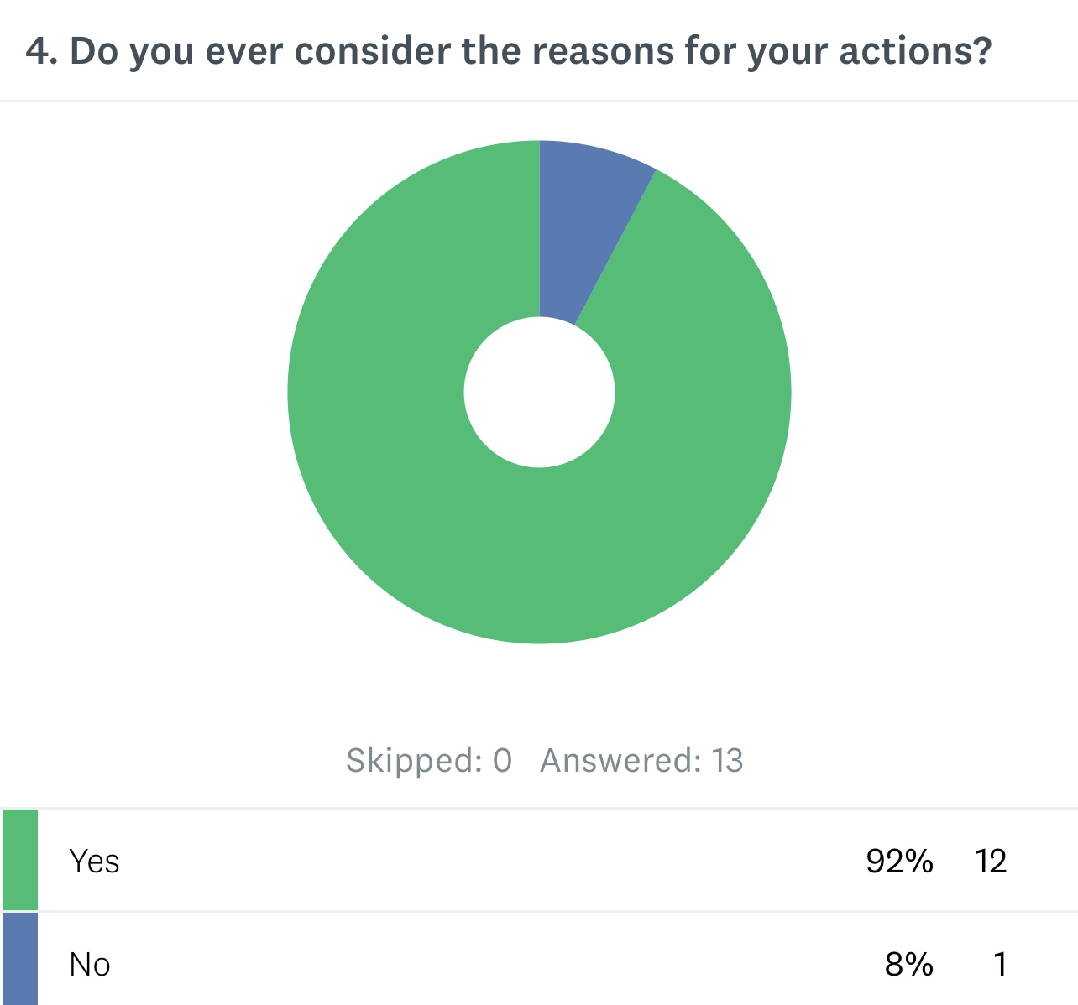
Social Acceptance & Reflection

Slide 12
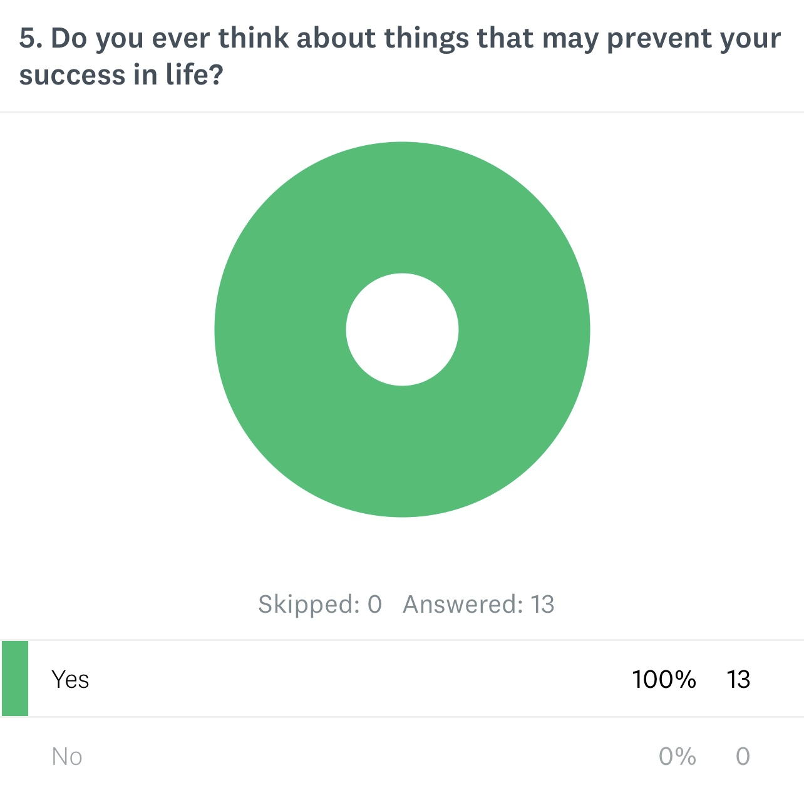

Adversity & Intraspection

Slide 13
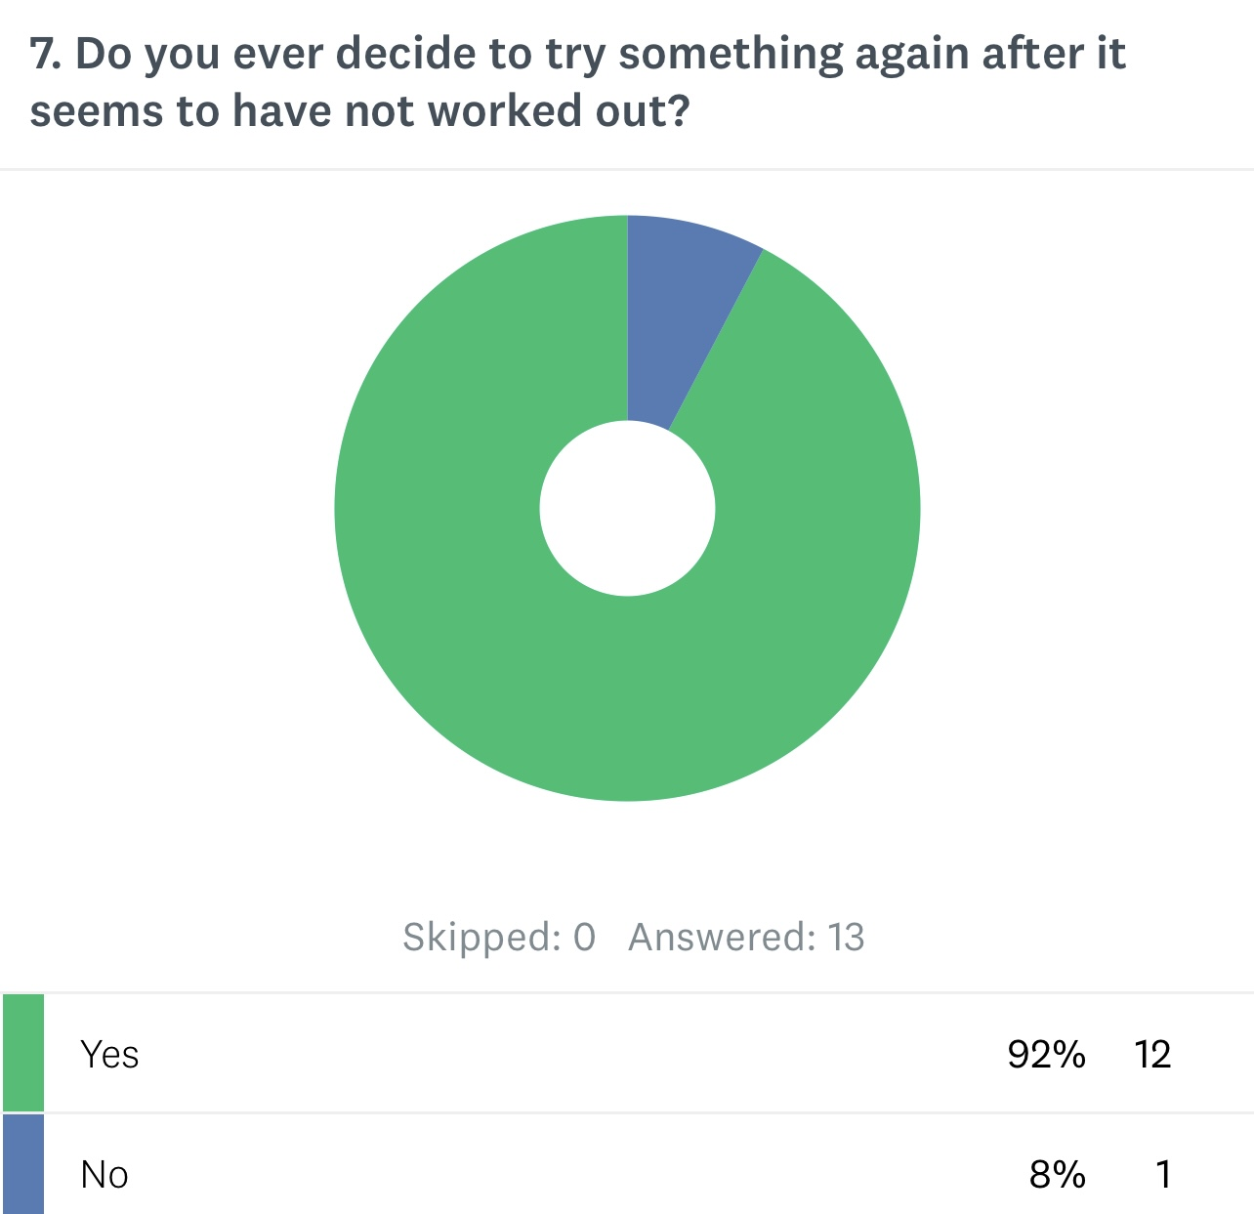
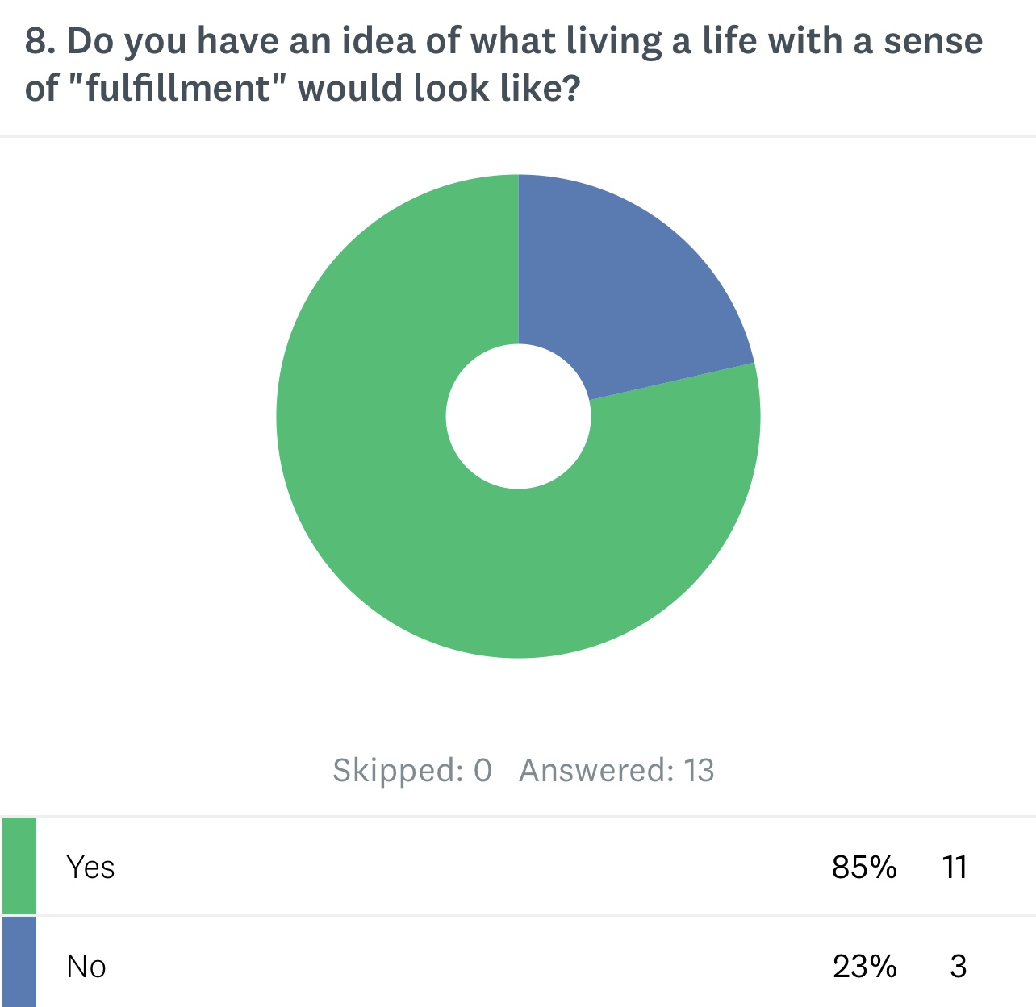
Perseverance & Goals

Slide 14
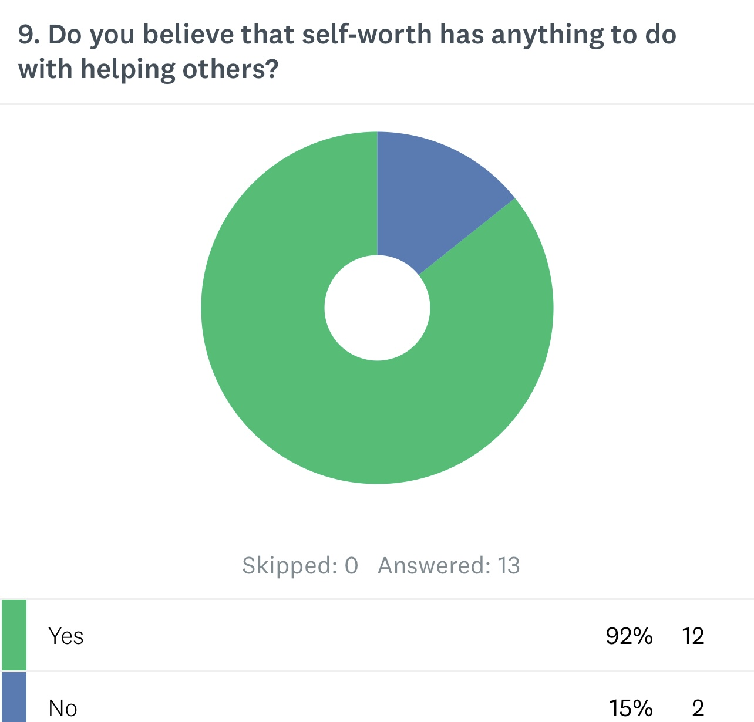
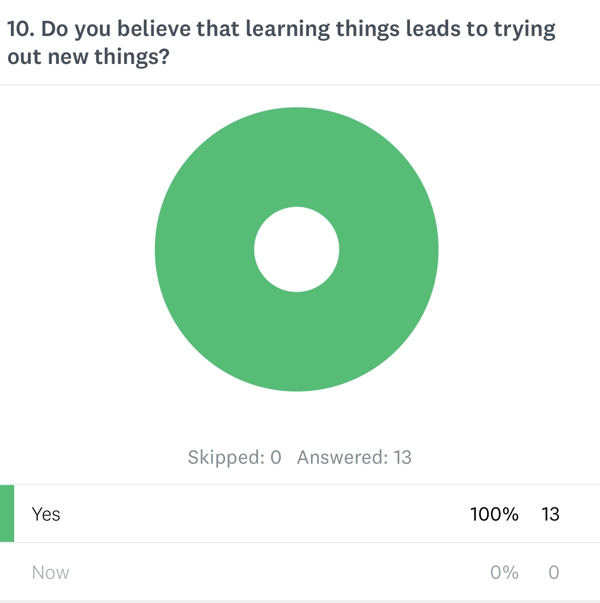
Community & Efficacy

