Slide 1
Agenda
Dr. Gail Hunter
Research Presentation Agenda
Overview/Rationale
The Zone Webpages
Comparing 2015 & 2024 Survey Results: InnerScape, The Self & Word Associations
Conclusion

Slide 2
Research Foundation
My 2nd master’s thesis is on the topic of Adol’ ID focused on the work of Seth Schwartz
My doctoral research topic was MC in CT based on the work of Manivong J. Ratts 2015/16,
which I have converted into a pro’ dev’ activity/course
My 1st master’s project is a multimedia production of Maya Angelou’s Inaugural Poem ‘On the Pulse of Morning’, listed on a commemorative website.

Slide 3
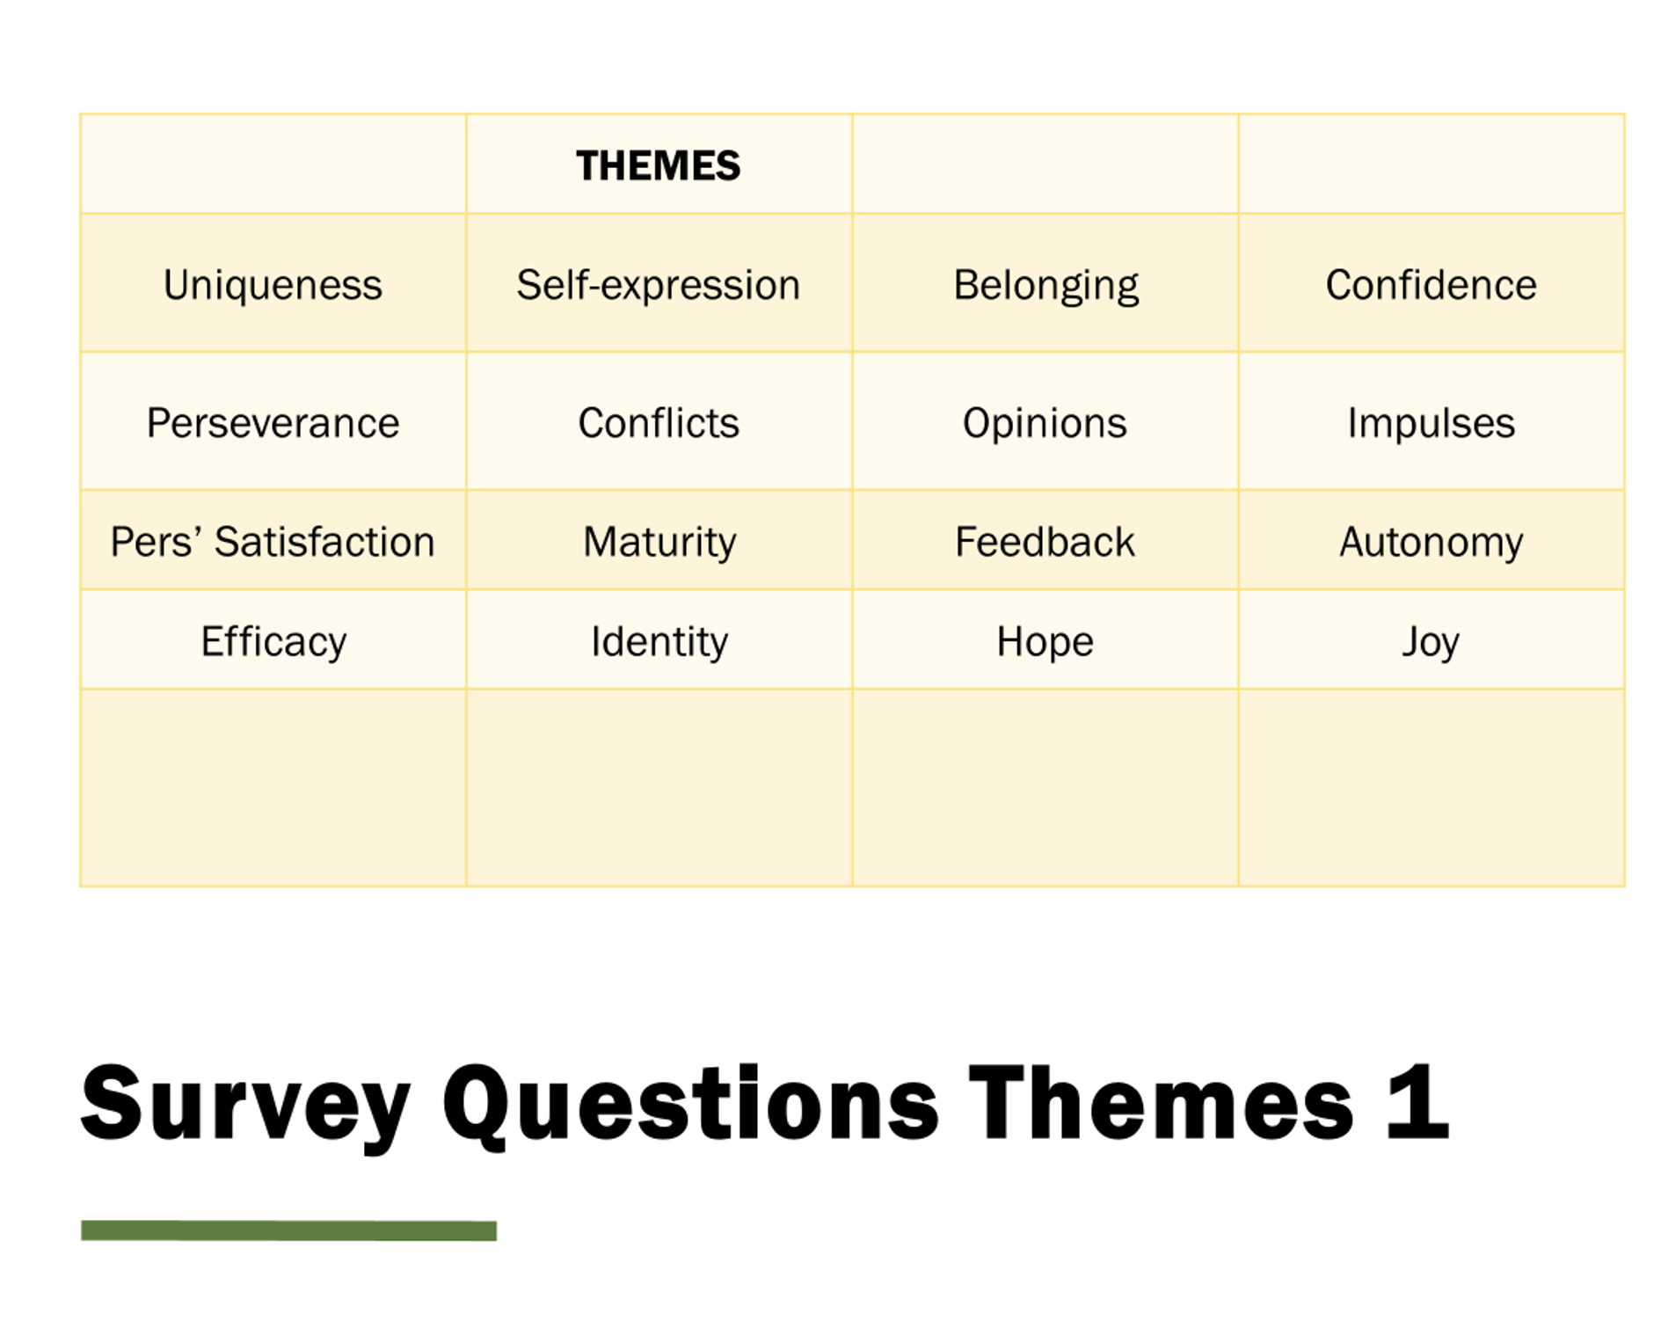

Slide 4
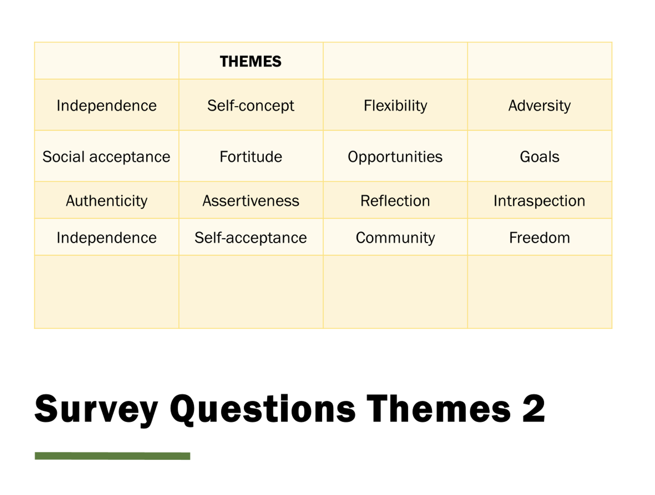

Slide 5
Word Association
Spring 2024
12/2013 – 1/2014

Slide 6
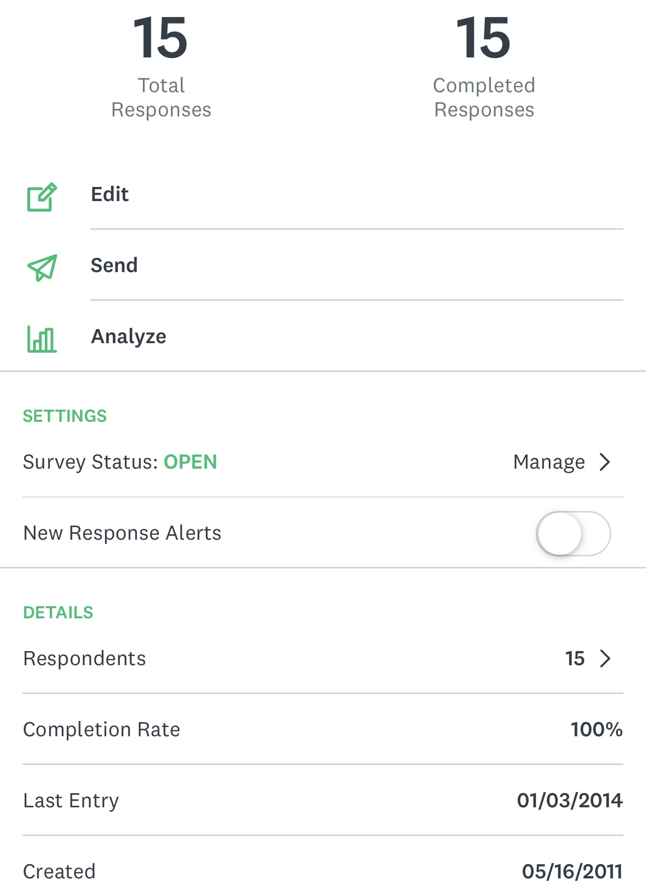

Slide 7
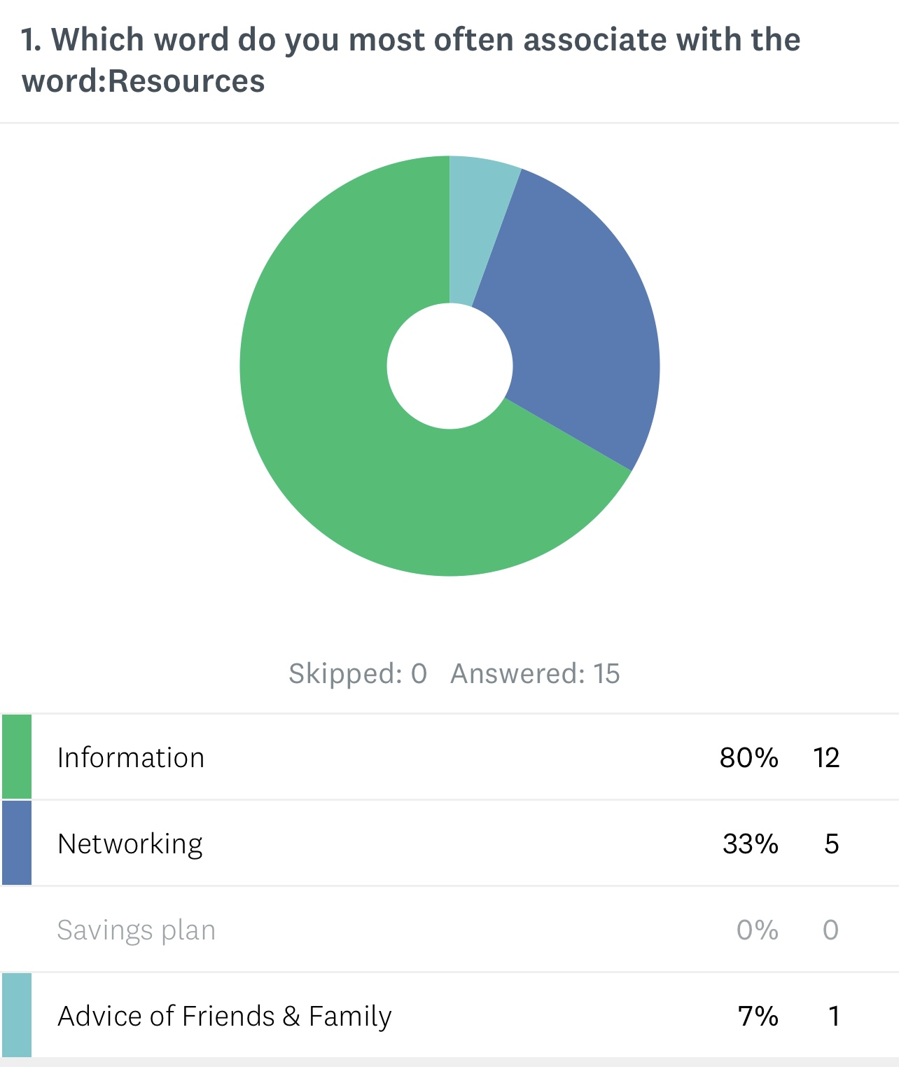
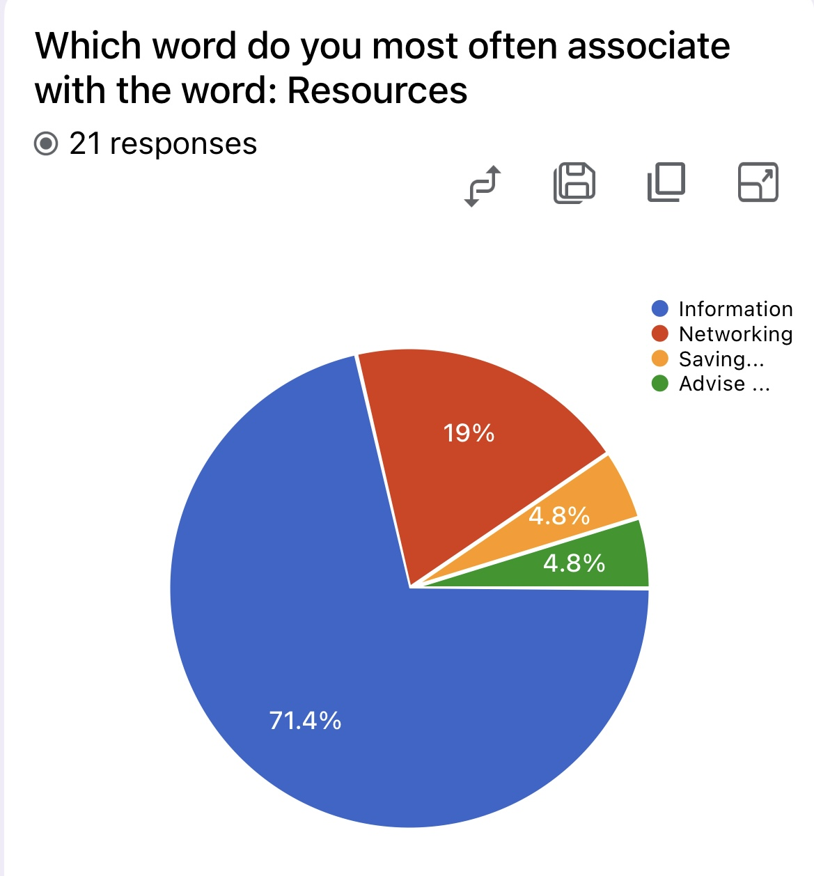
Support

Slide 8
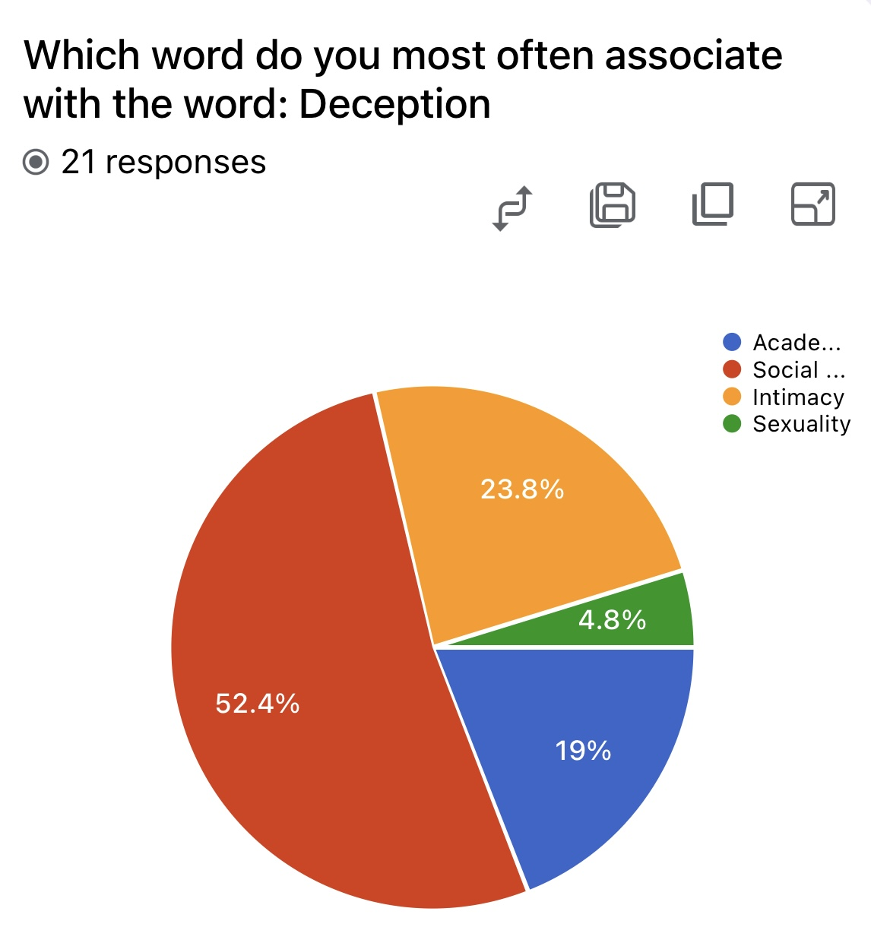
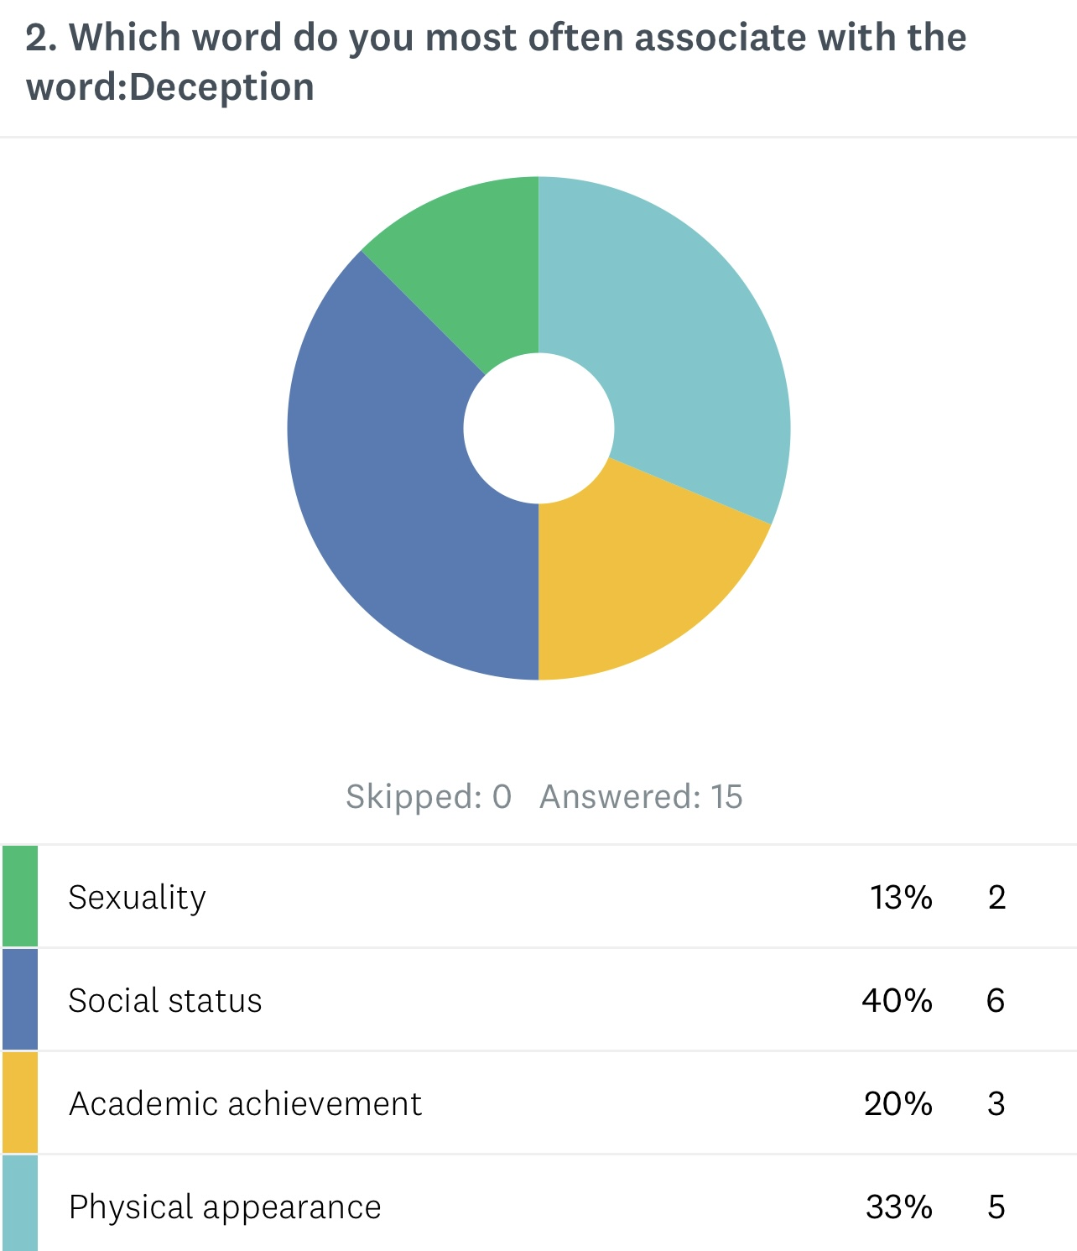
Relevance of Authenticity

Slide 9
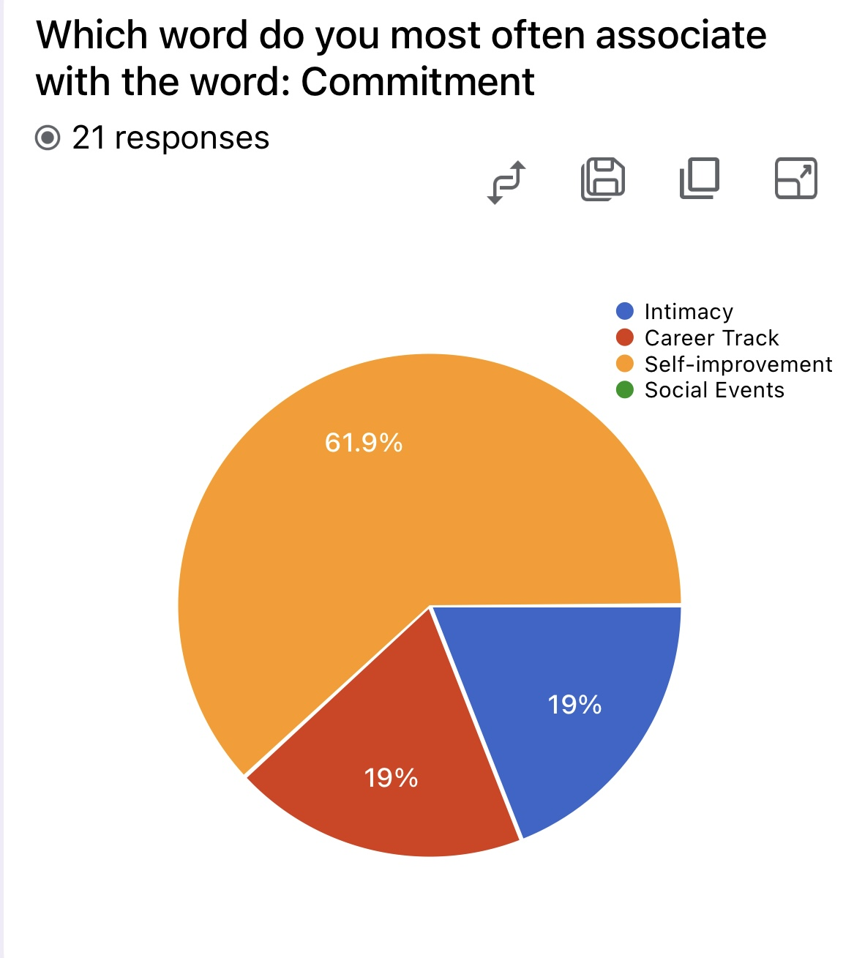
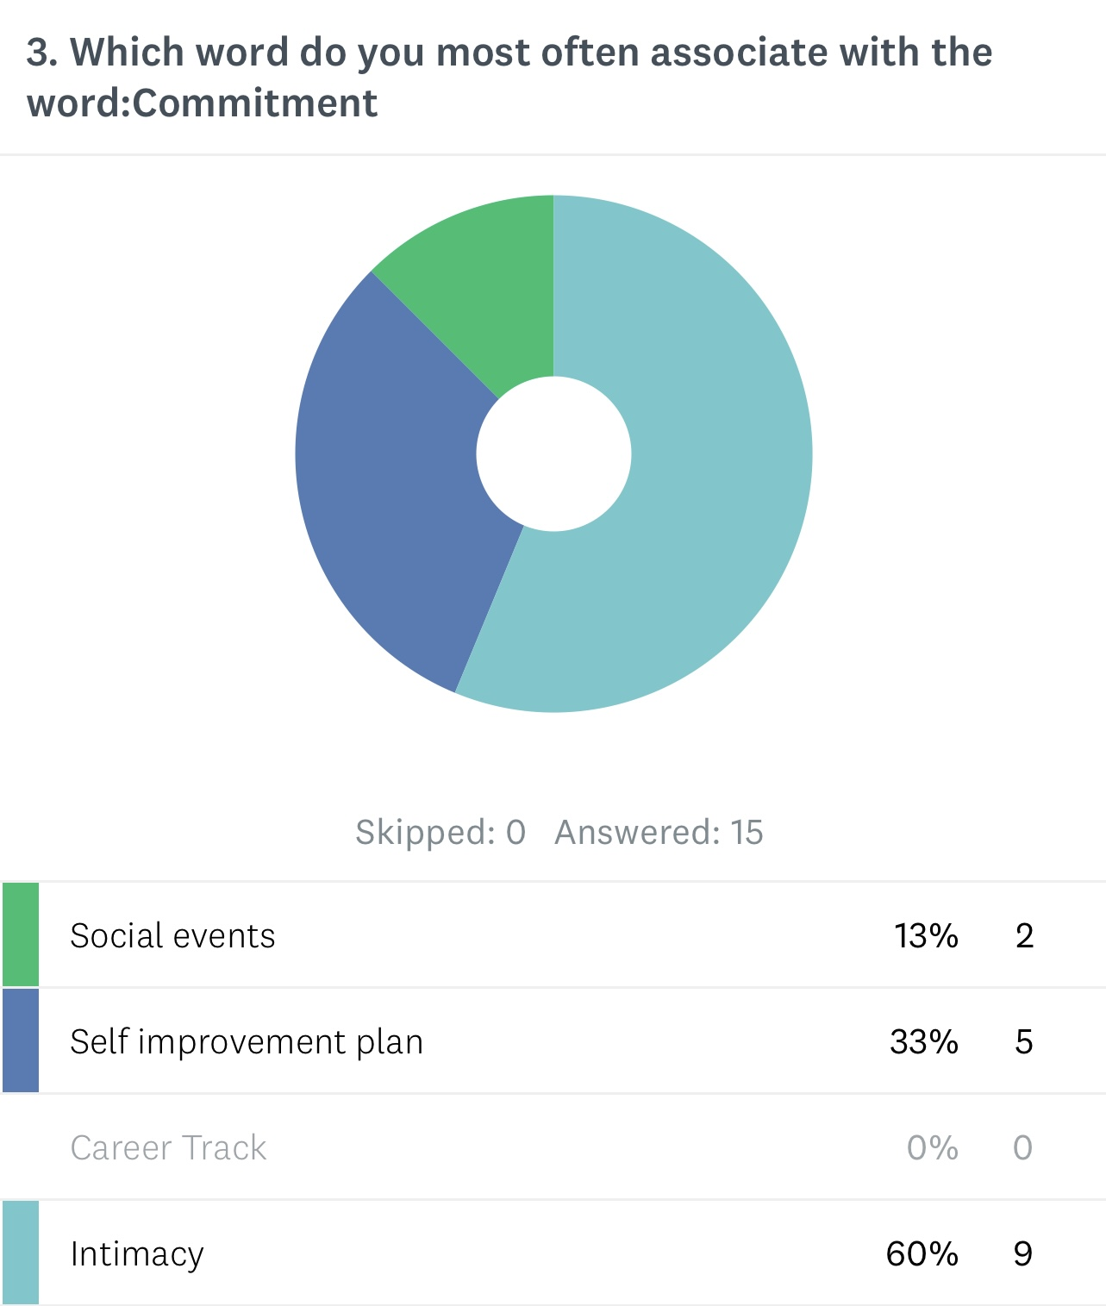
Identity Achievement

Slide 10
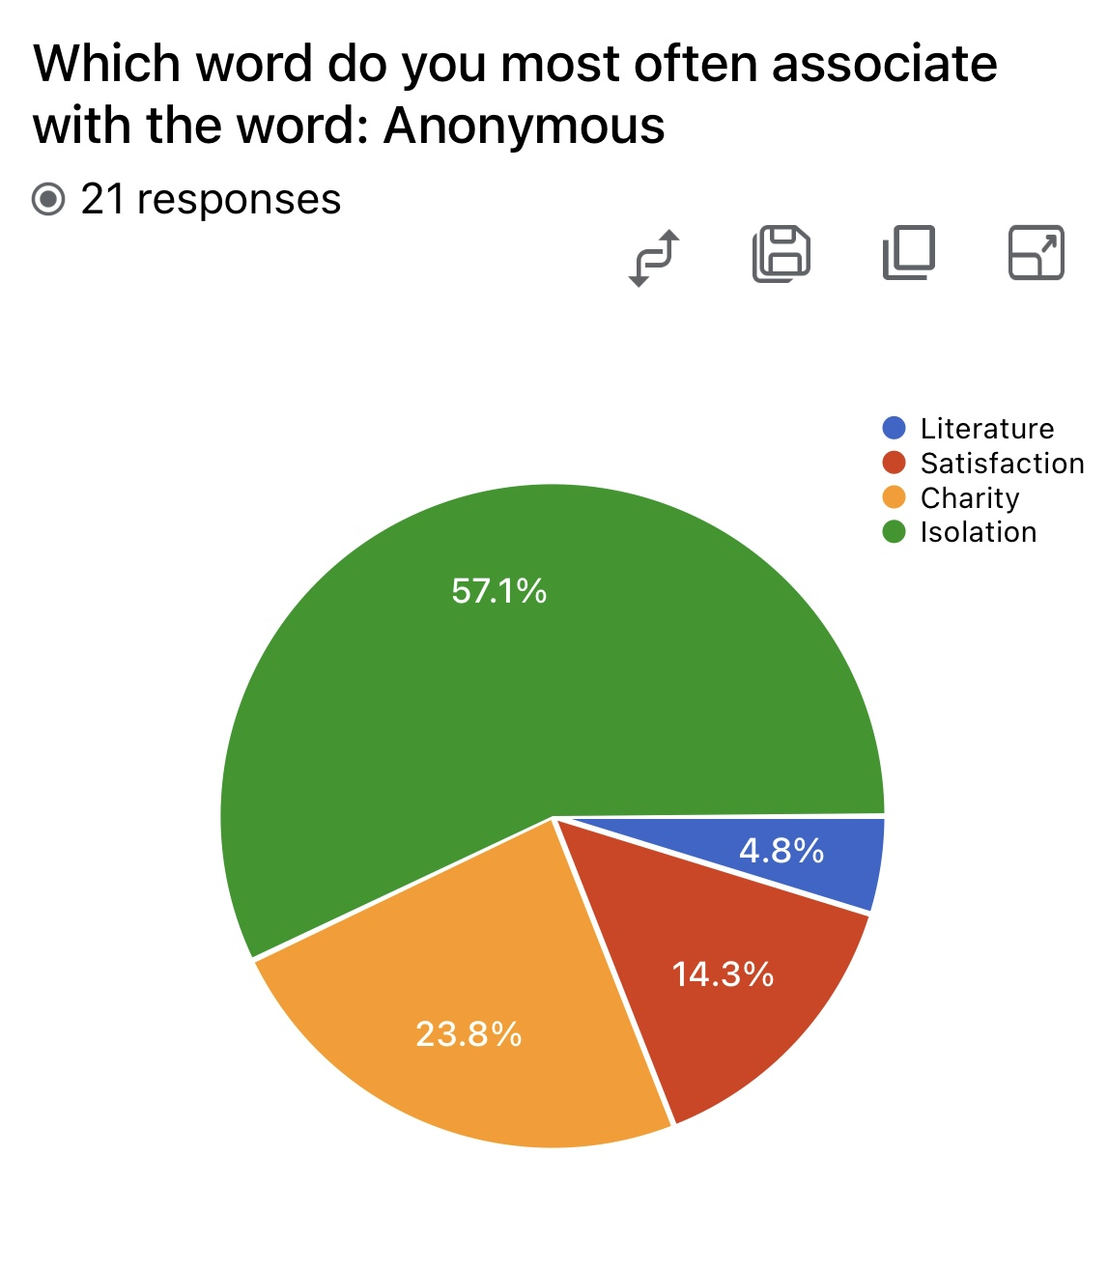
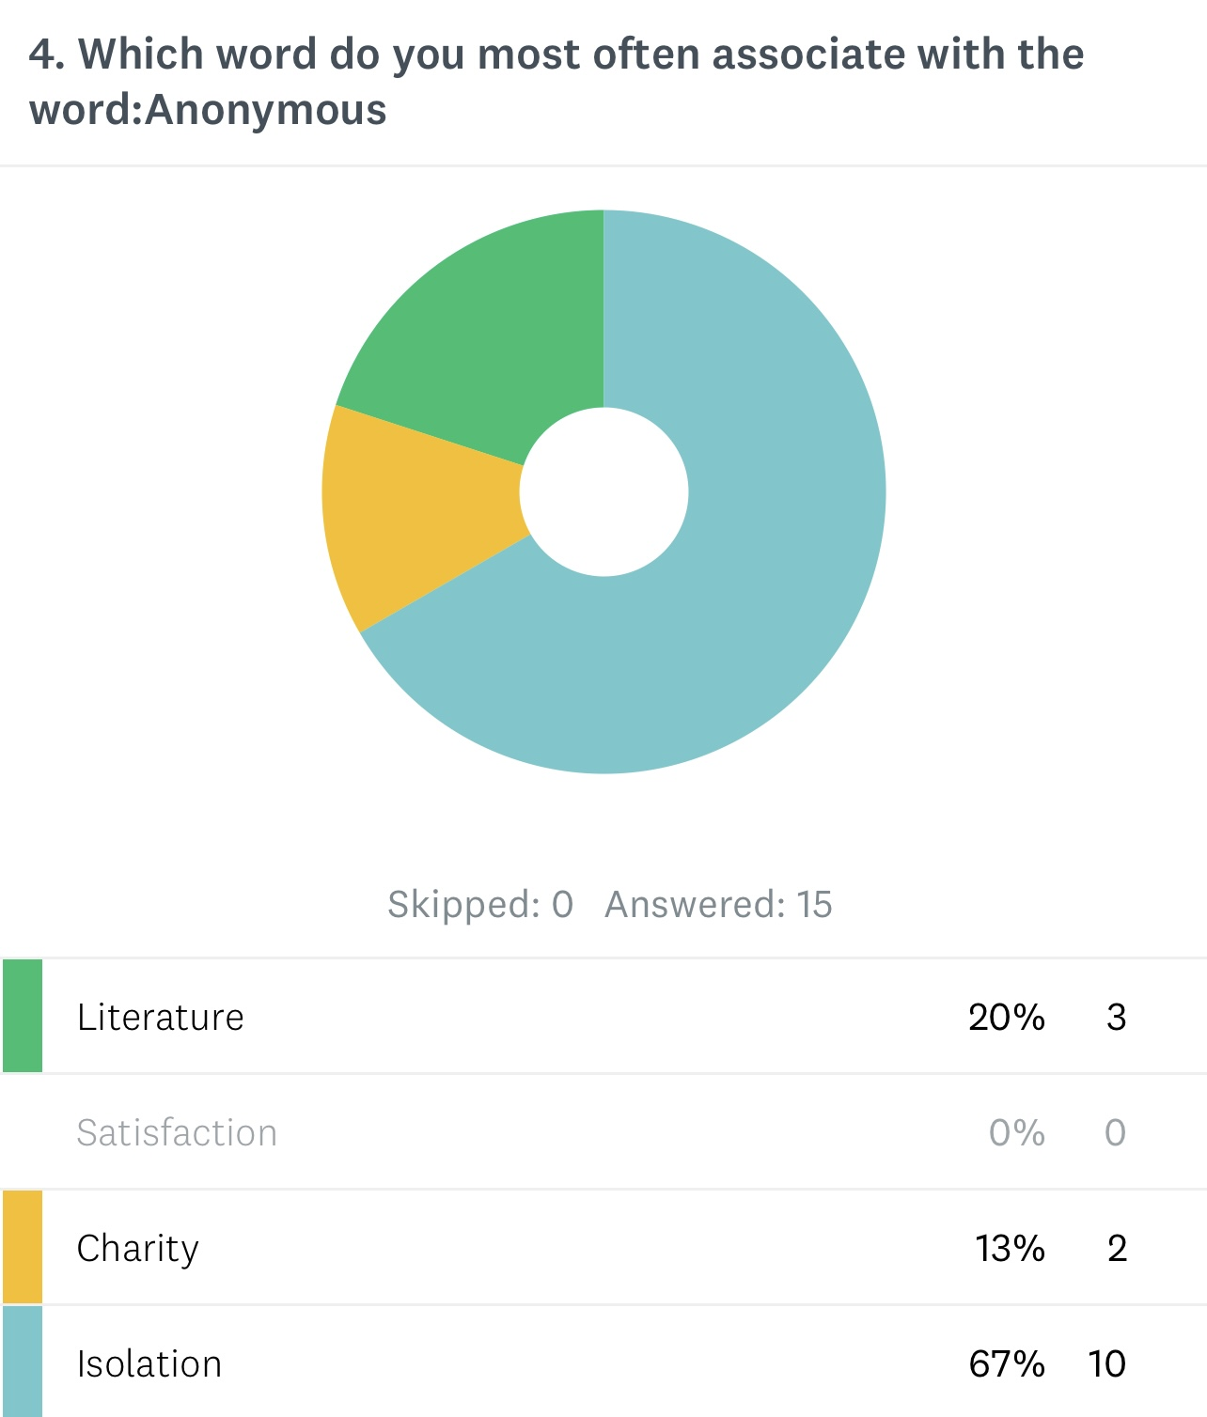
Connectedness

Slide 11
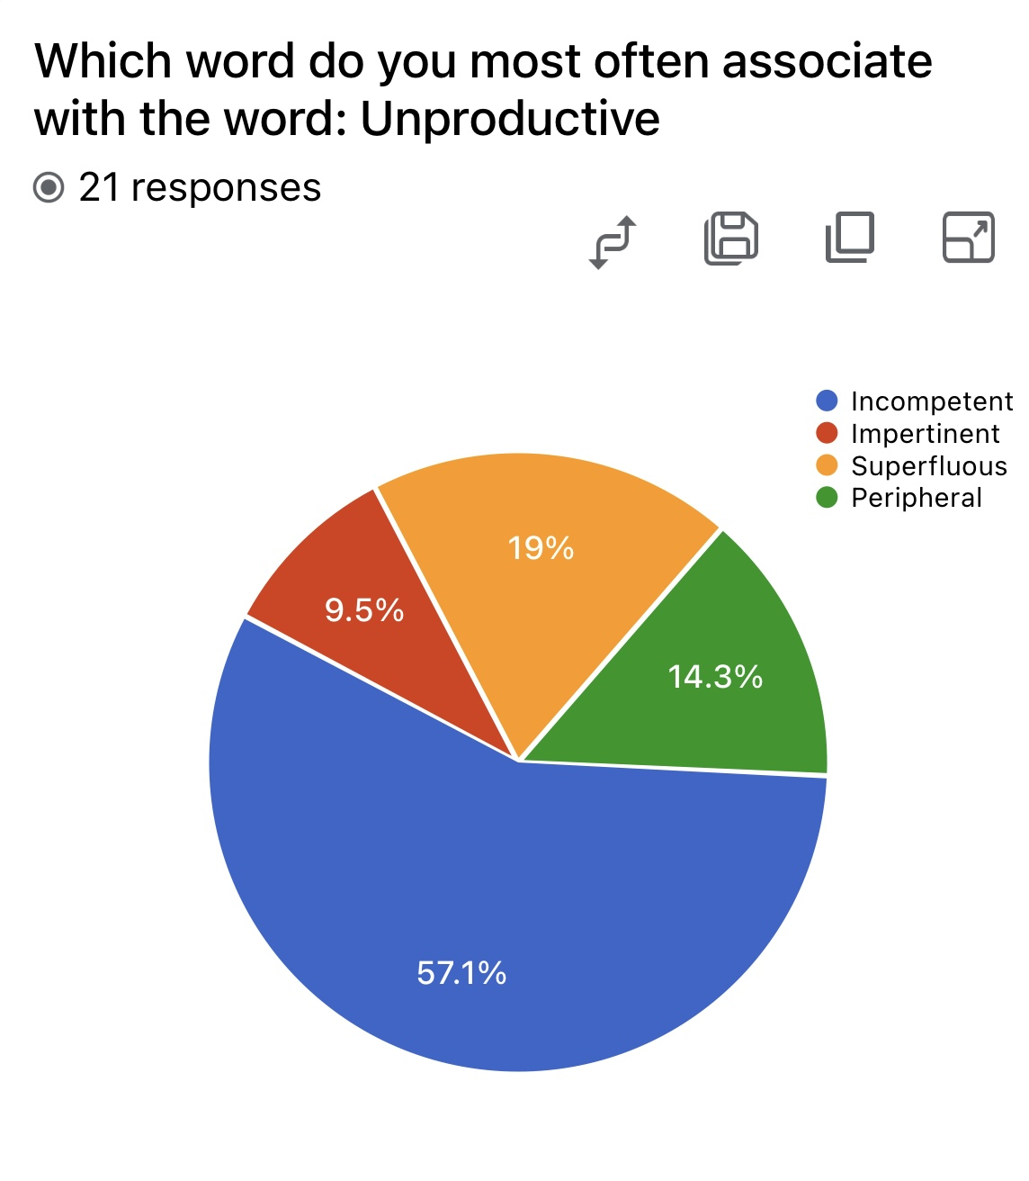
Efficacy

Slide 12
Innerspace
Spring 2024
4/2014 - 11/2023

Slide 13
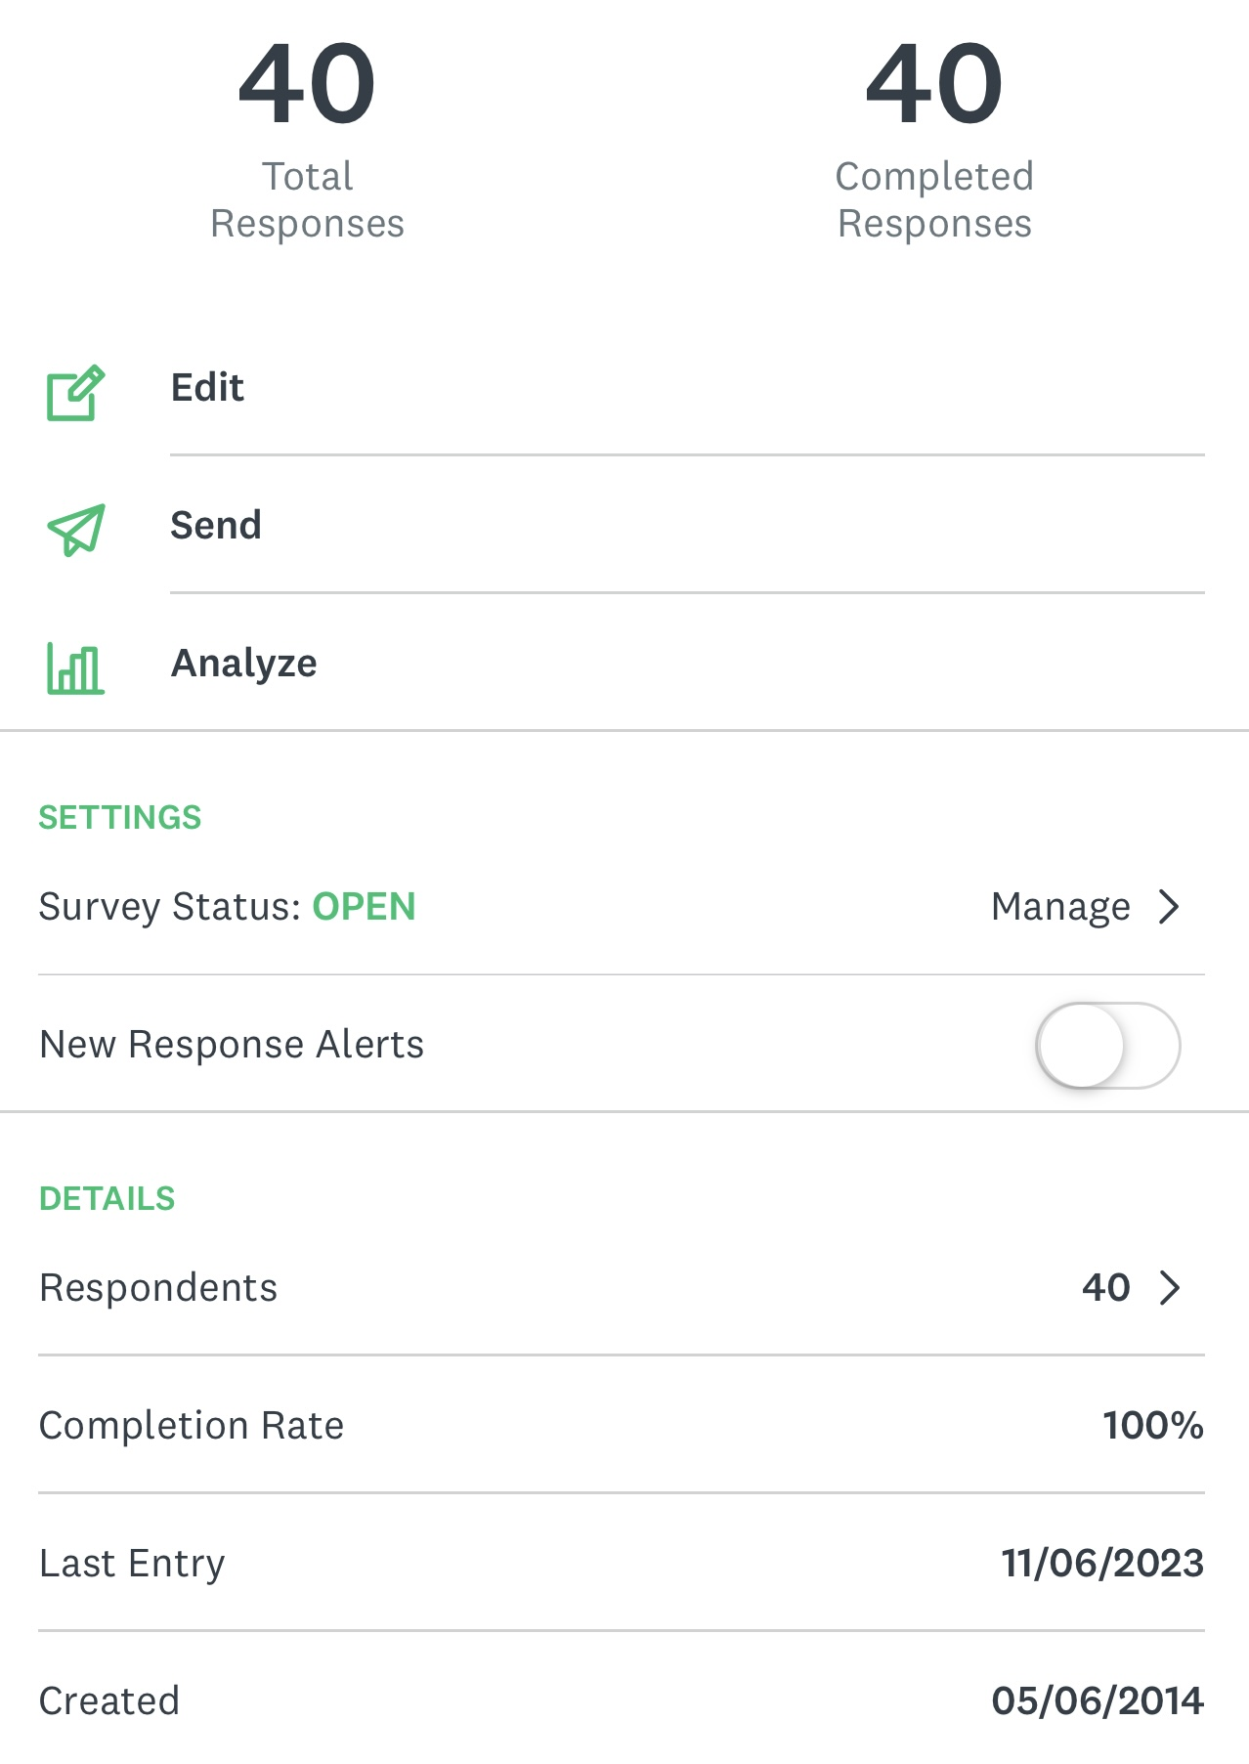
Including
Spring & Fall 2023
WAU Students

Slide 14
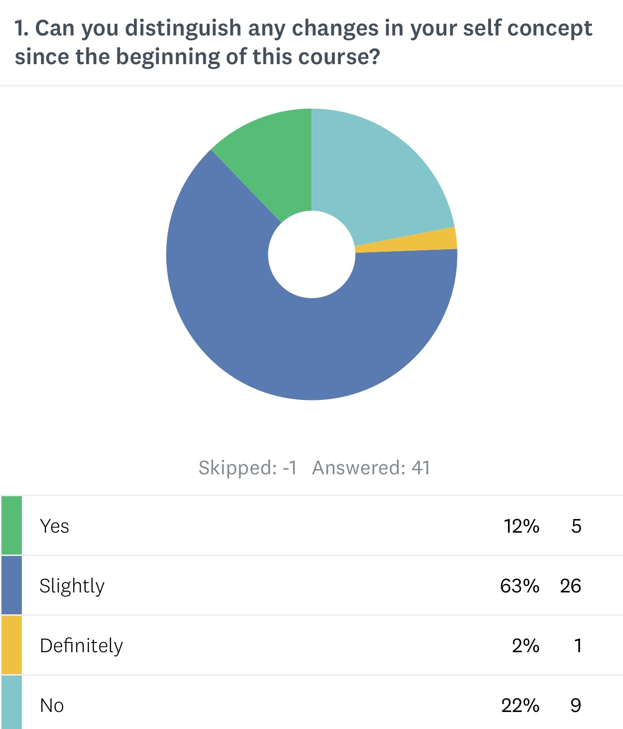
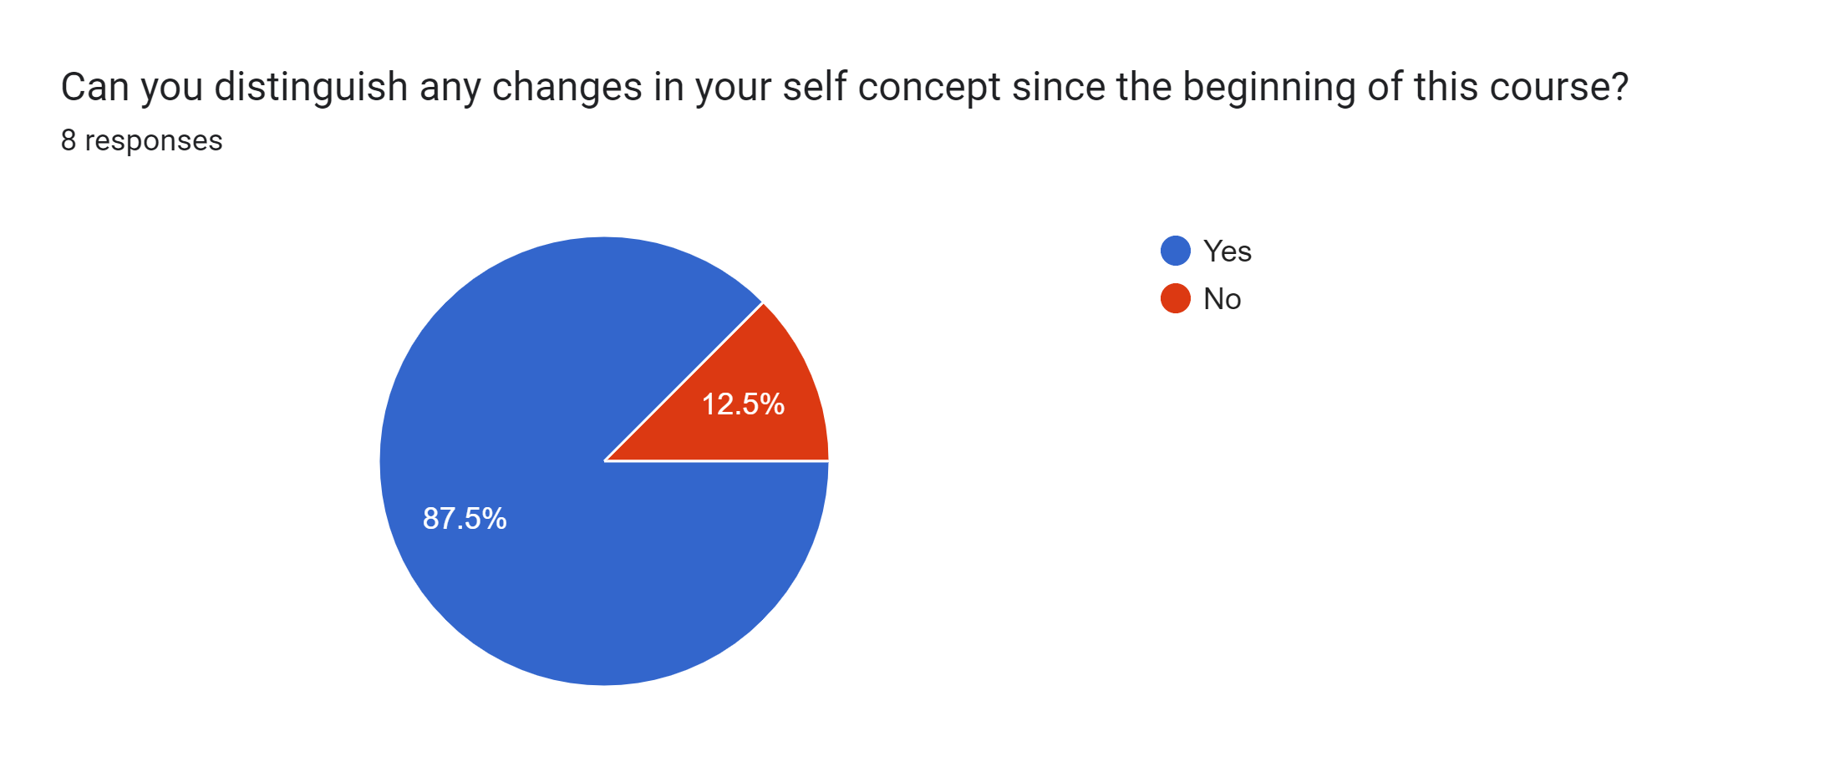
Course Effectiveness

Slide 15
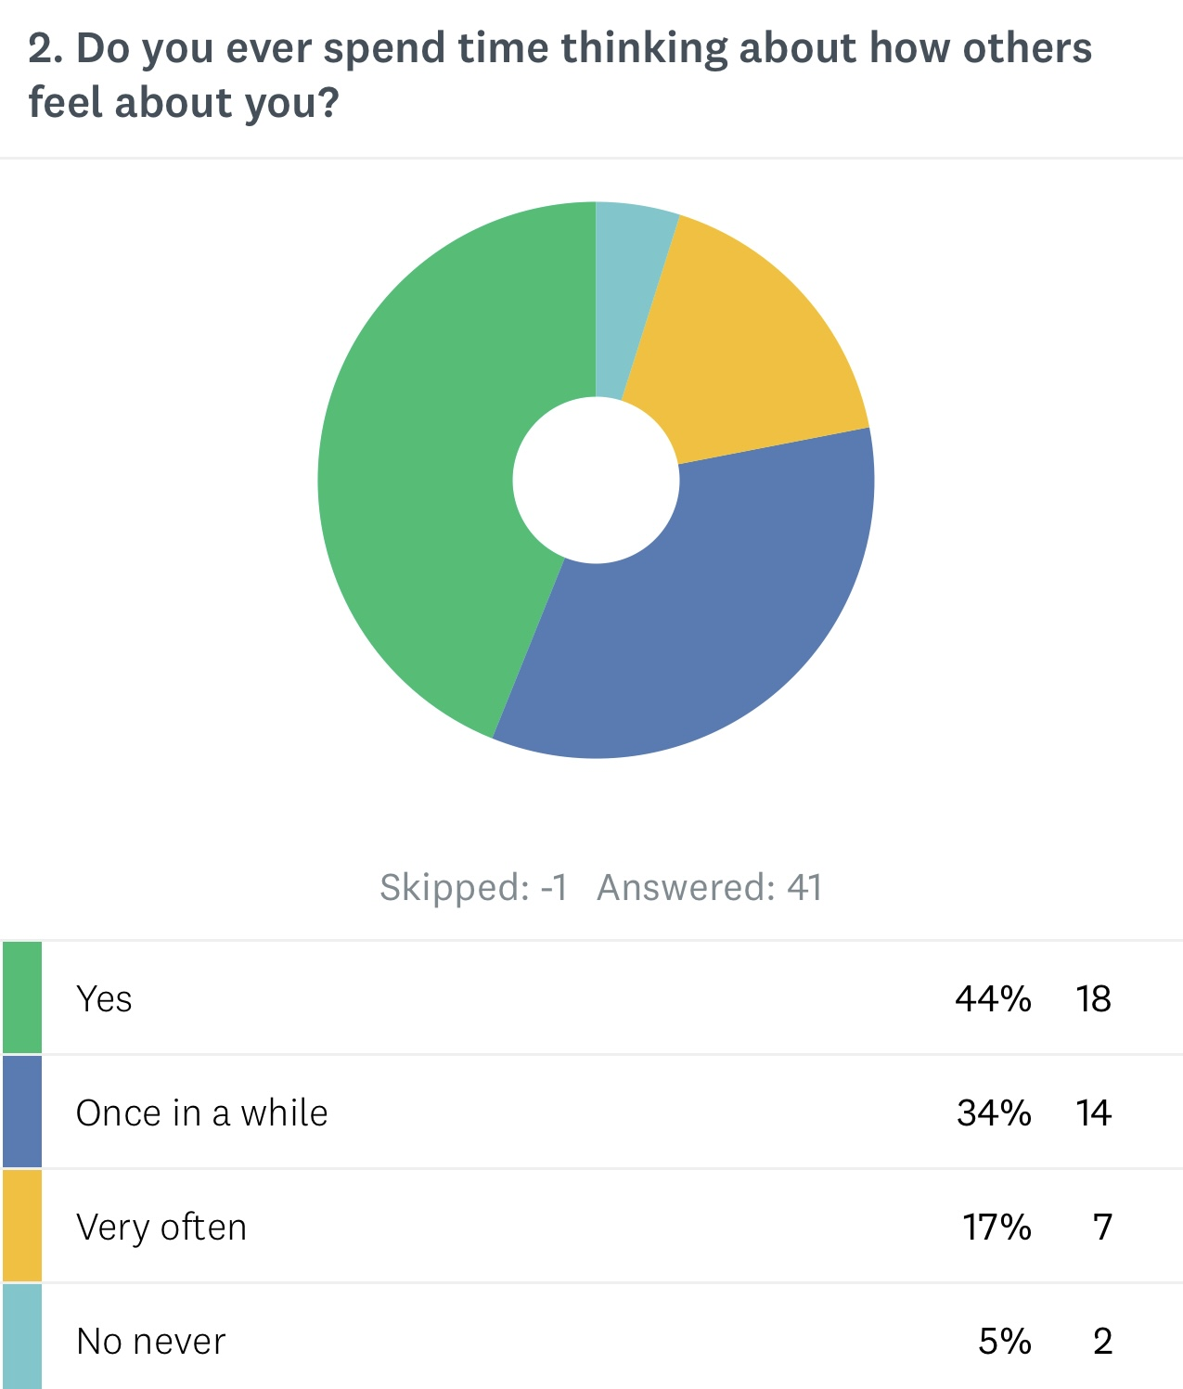
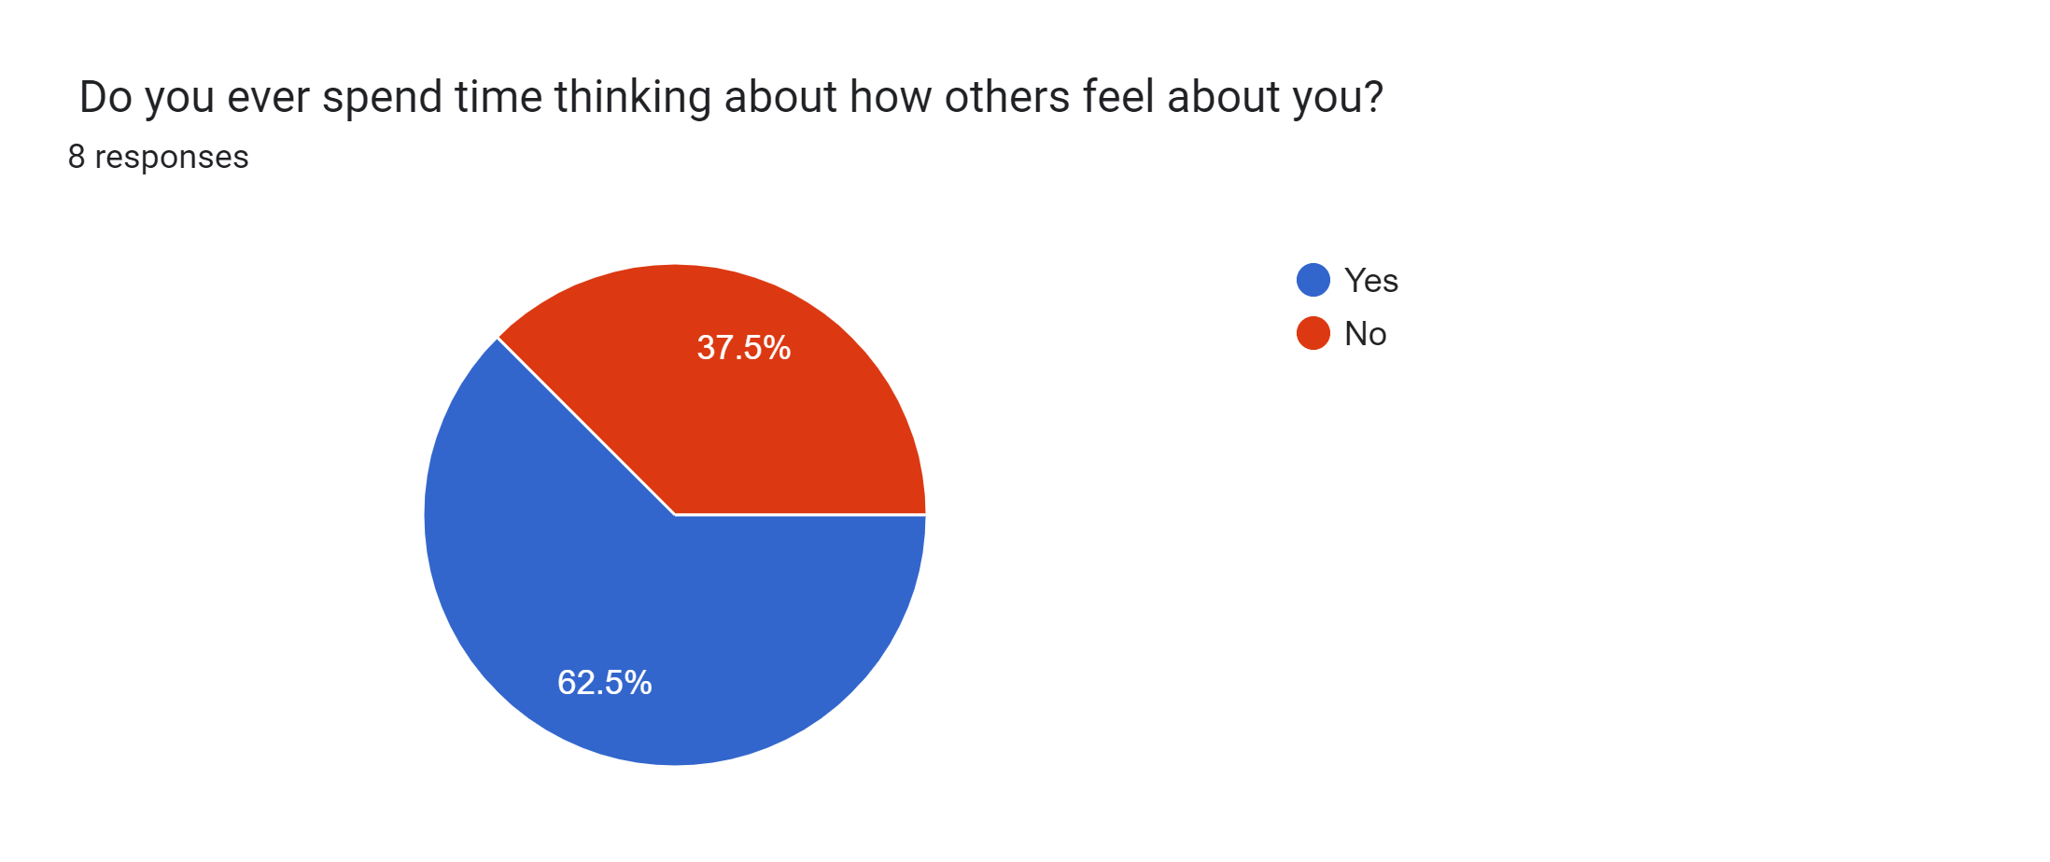
Opinions

Slide 16
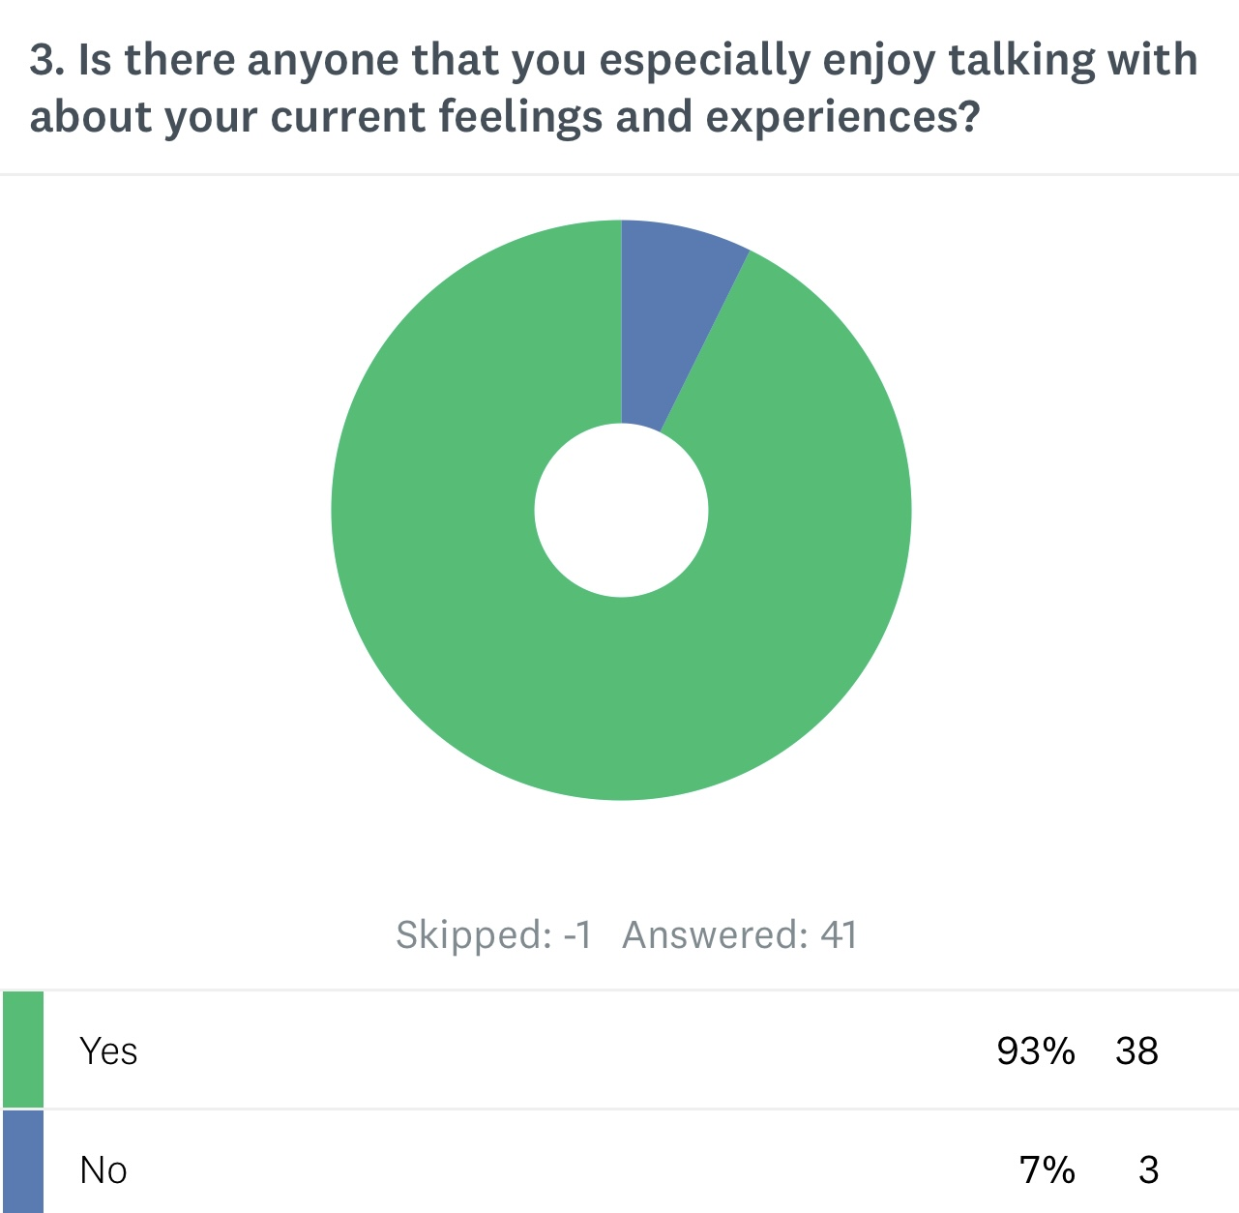

Connection

Slide 17
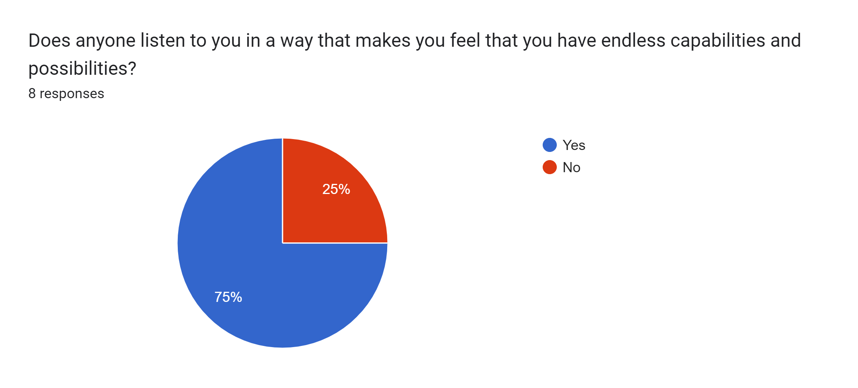
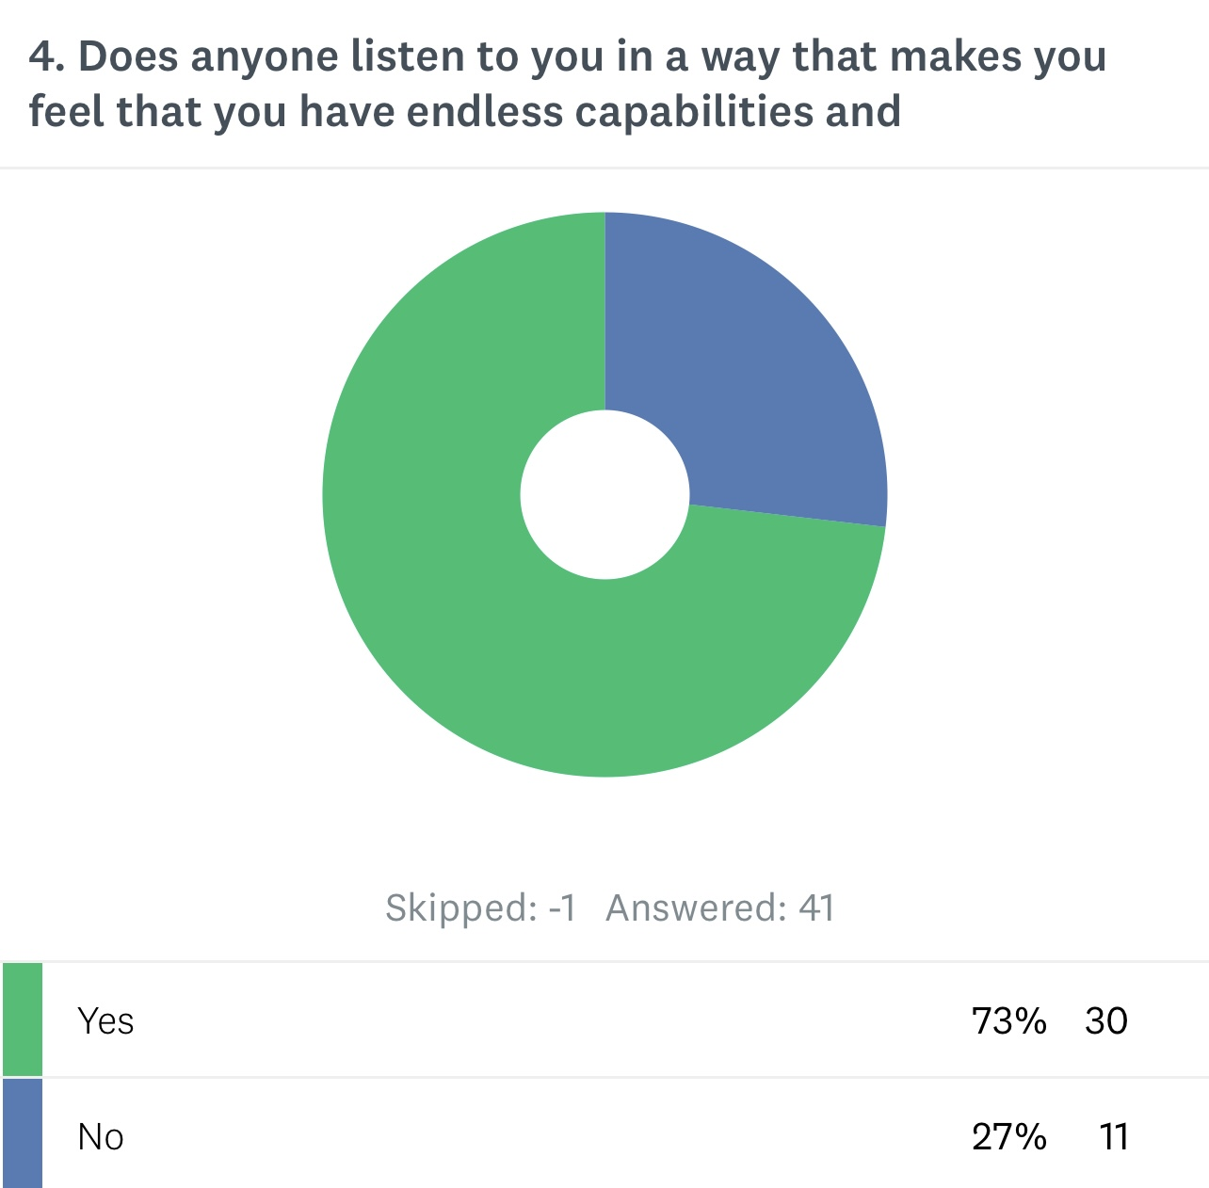
Free to Dream

Slide 18
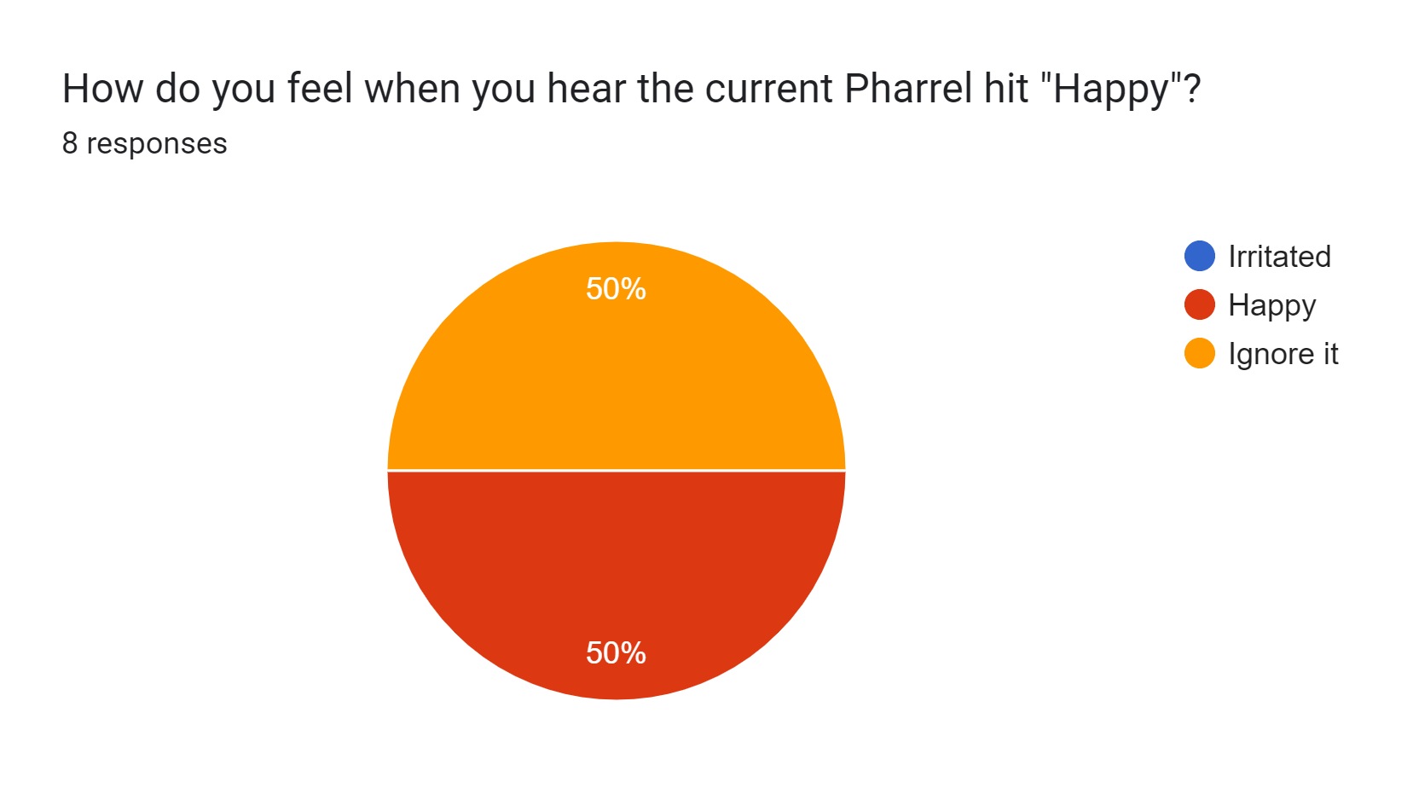
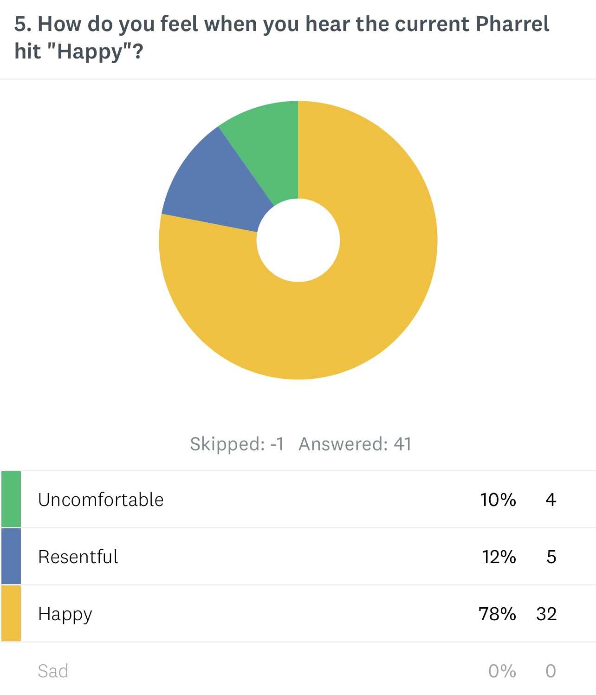
Joyful Spirit

Slide 19

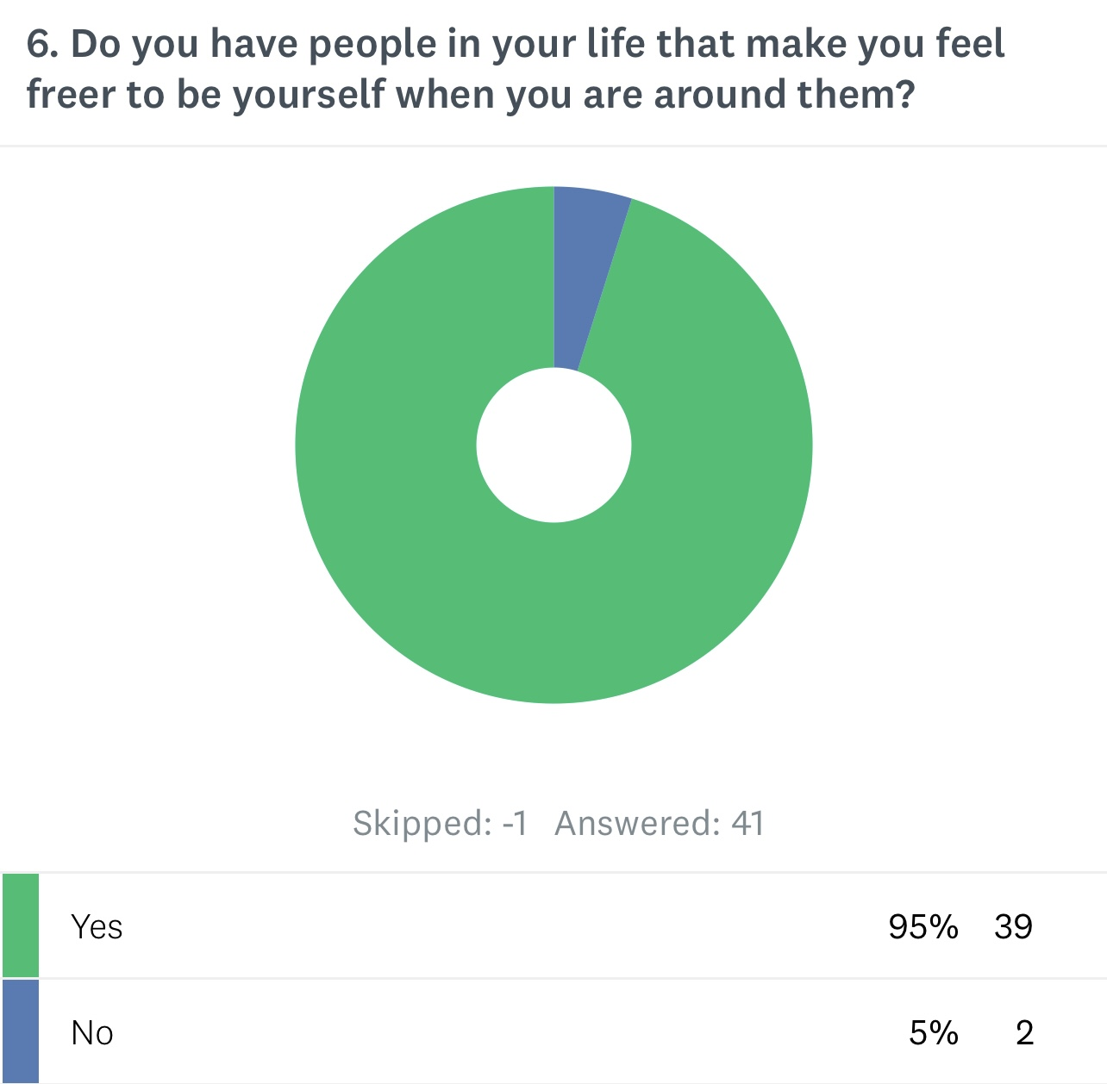
Safe Zone

Slide 20
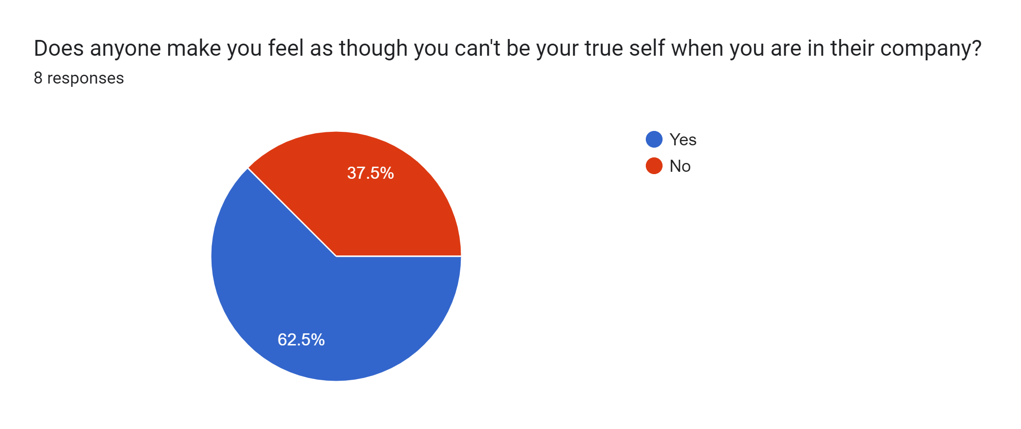
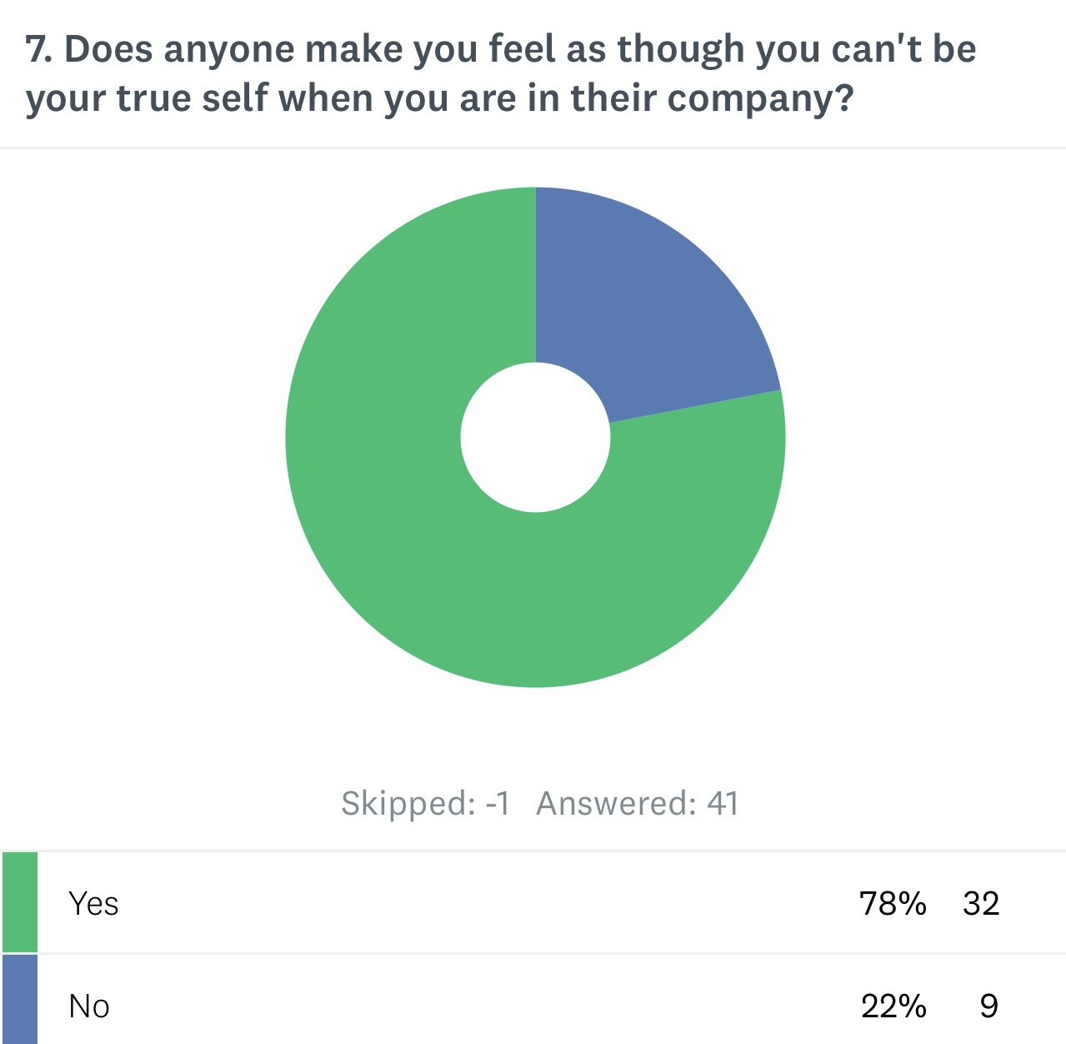
Restrictions

Slide 21
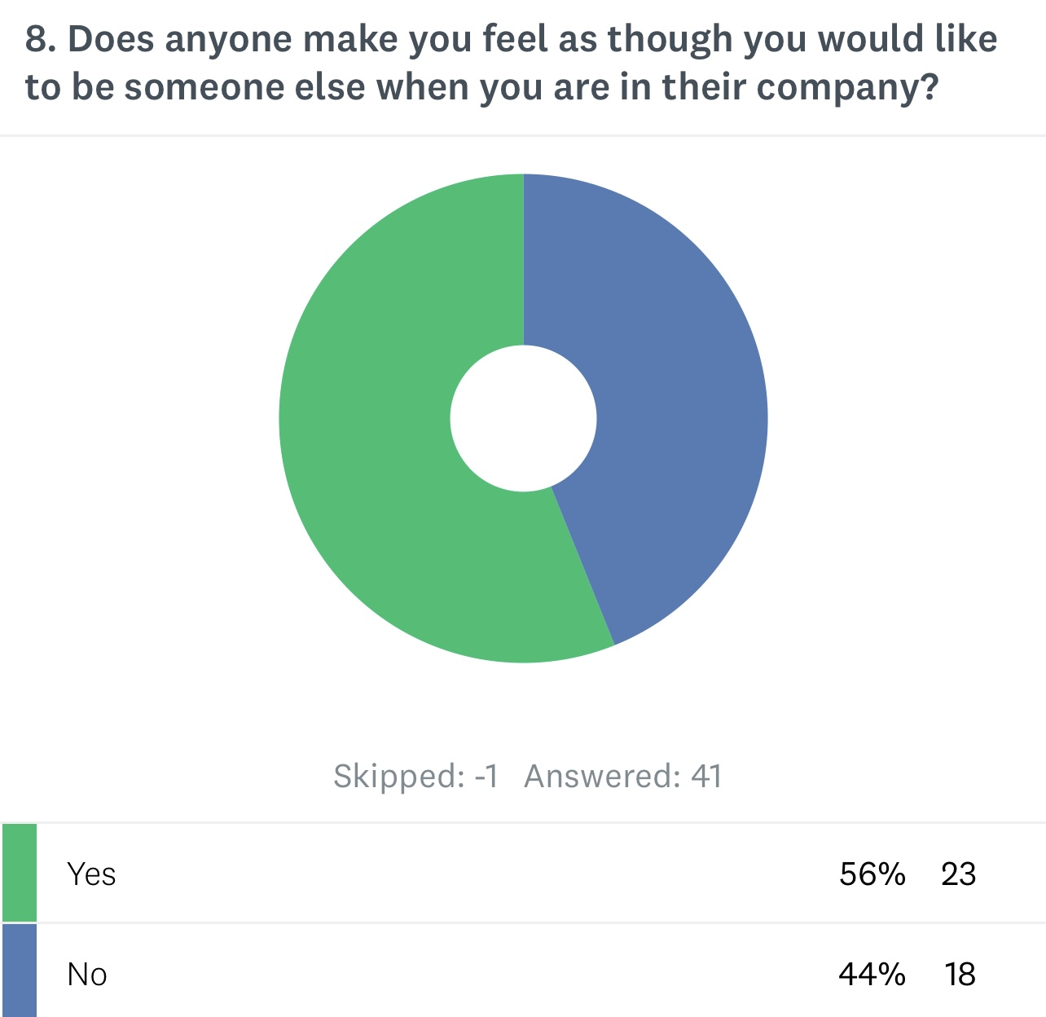
Room to grow

Slide 22
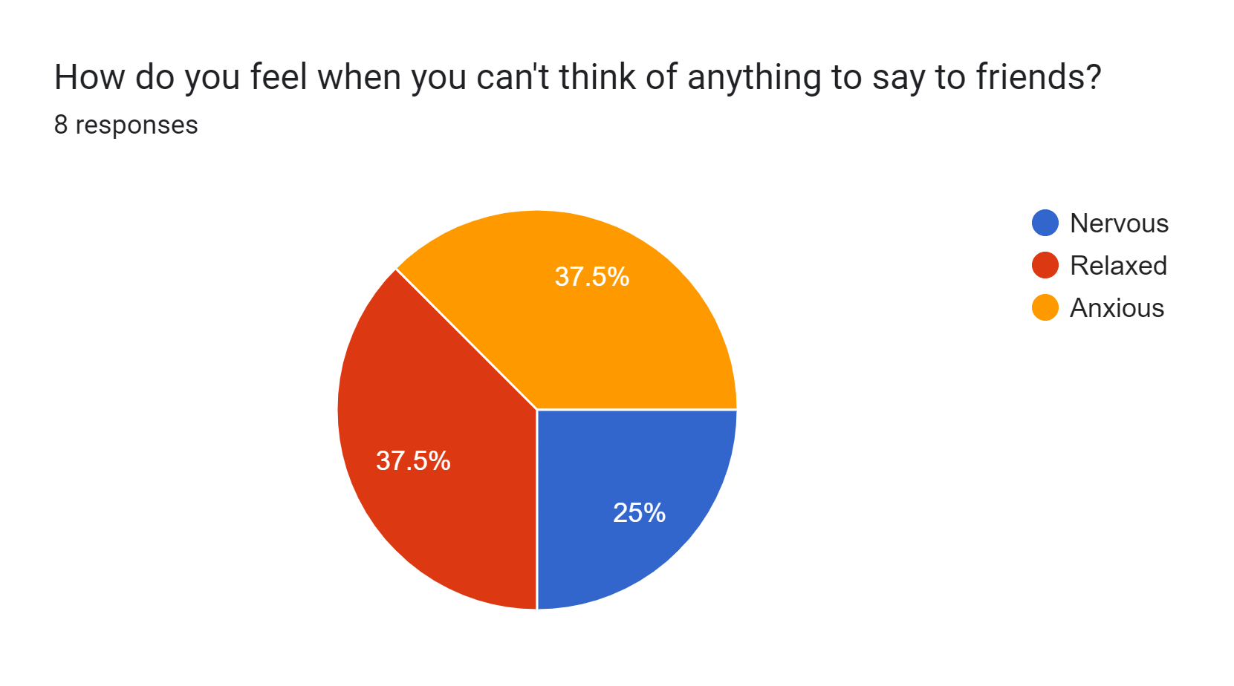
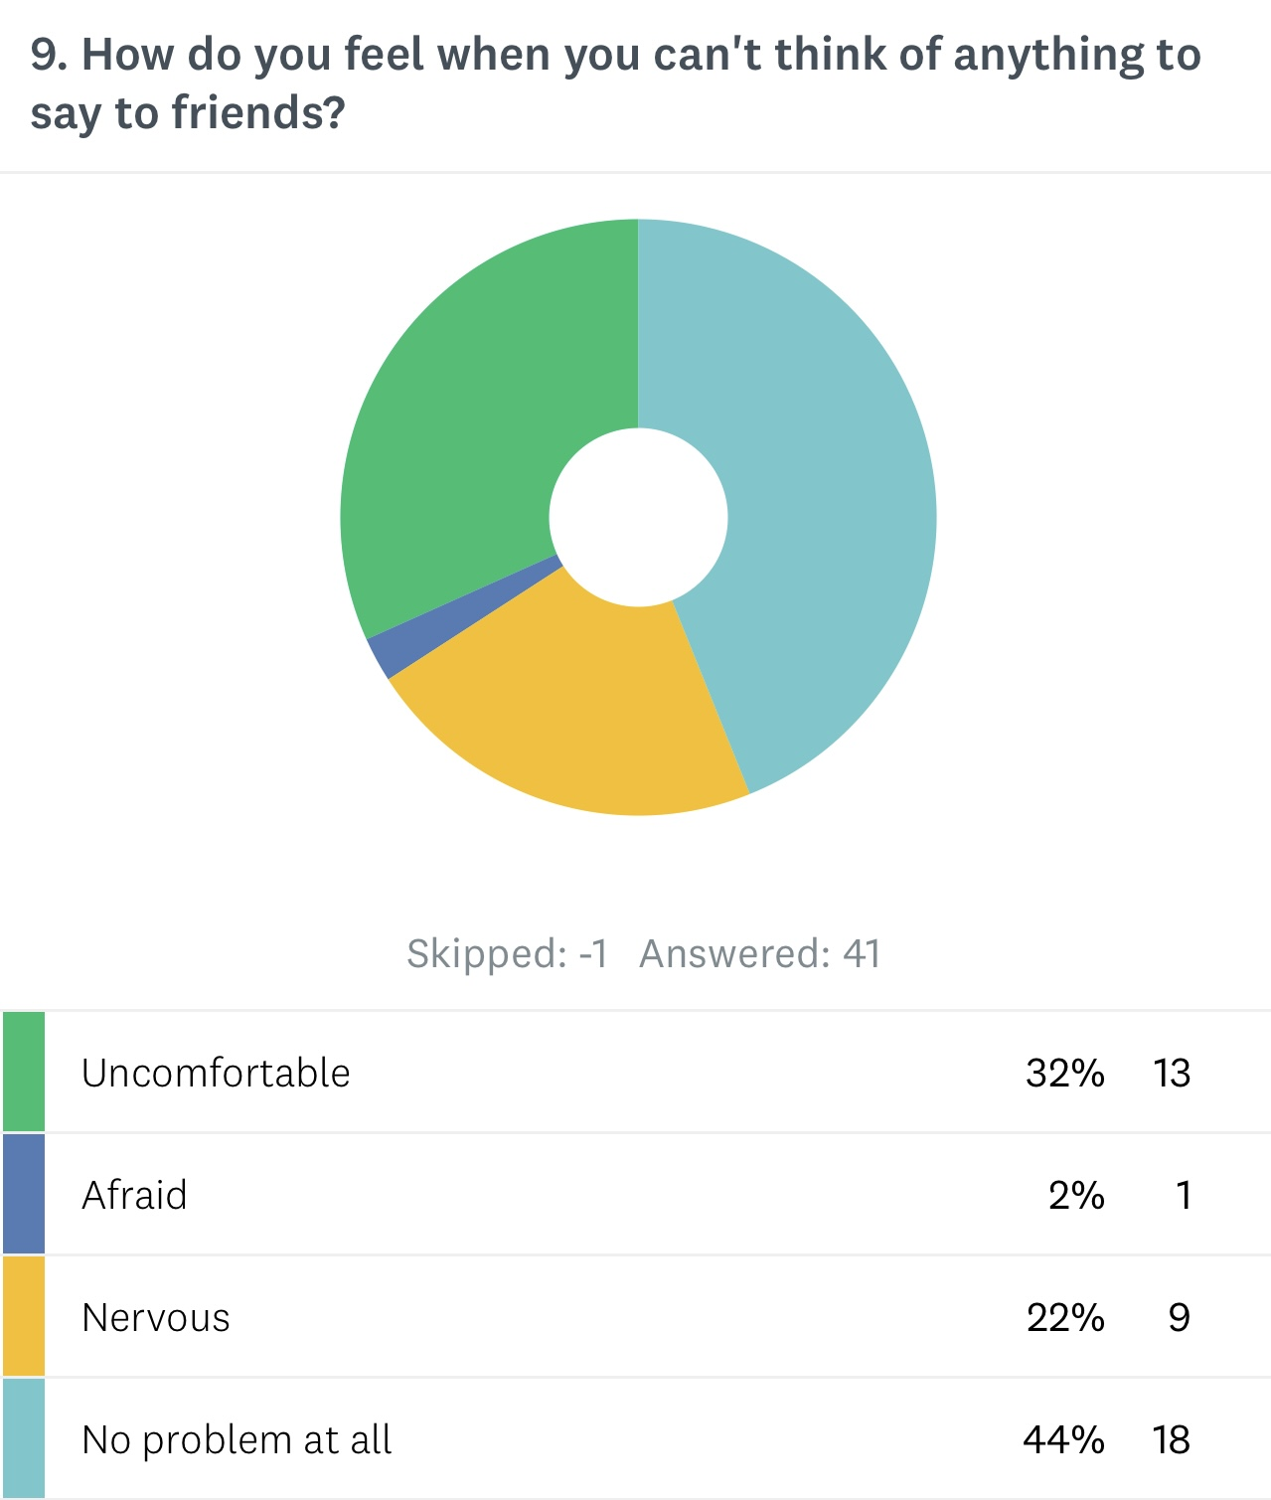
Feel At ease

Slide 23
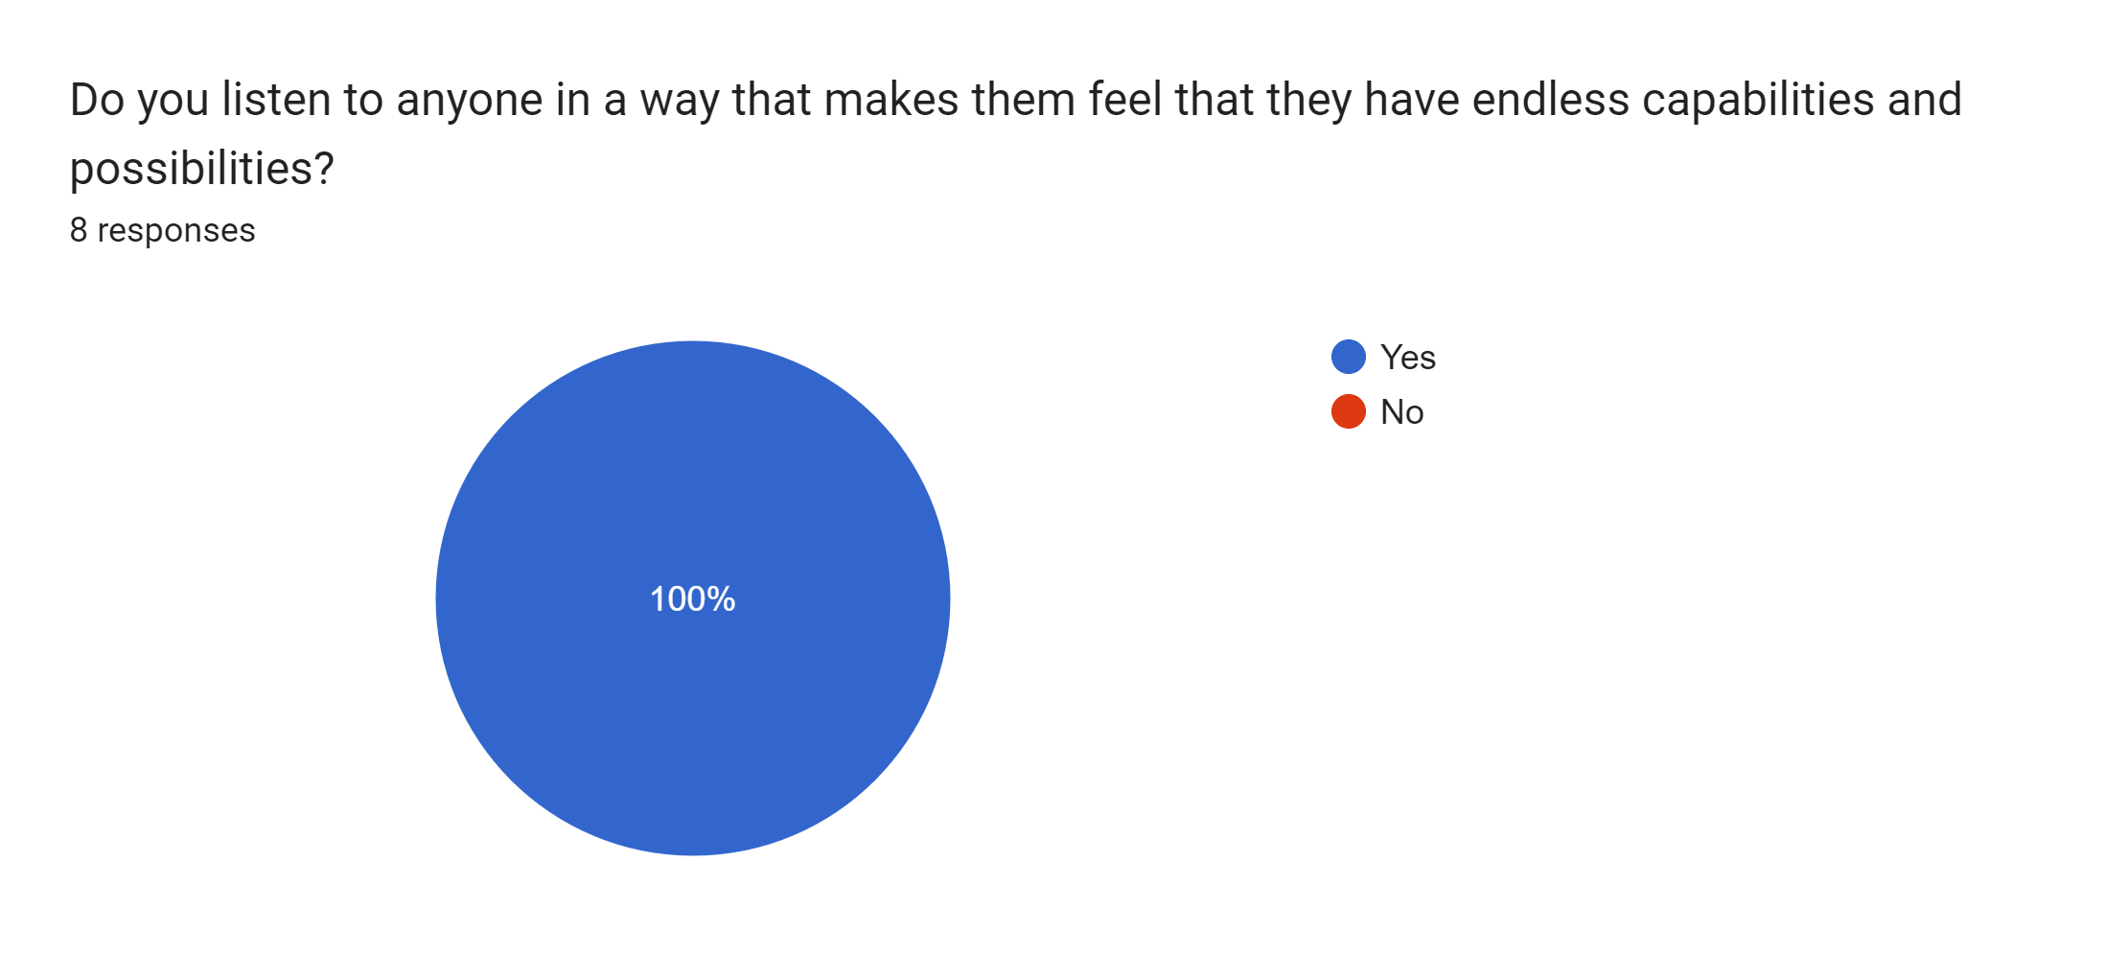
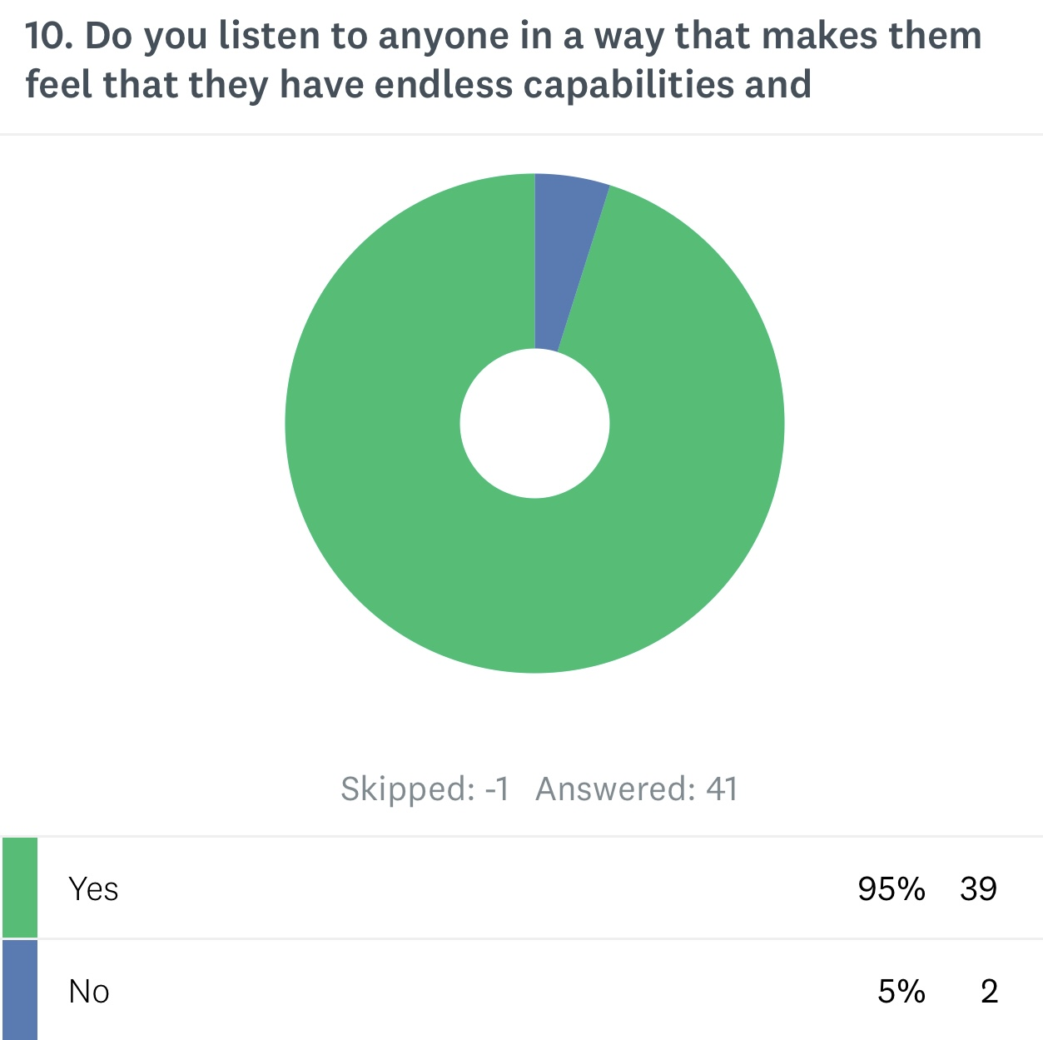
Hope & Efficacy

Slide 24
Thank you
Dr. Gail Hunter
267-456-8868
Ghunter@wau.edu
gaillouisehunter.wixsite.com/psychology

